Slide 1
Steaming and curving solid wood
Module 3
WULS
Warsaw, 1st December 2021
Notes:
In this module was prepared as part of the All Hands On Deck (AHOD) project, activity IO2A3.
The substantive transmission of the manual is the absolute minimum of sailing knowledge necessary to build a small boat in workshop conditions.
This portion of the message should be assimilated by every hobbyist of sailing.
This is also what every enthusiast of this sport should know to understand roughly the principles of sailing boat construction.
Every sailing enthusiast should improve their skills, looking for the best technique for building their dream boat.
This can be learned in two ways: either through painstaking practice or from public experience. For those who prefer the desire to acquire reliable knowledge over to the written word, further chapters are intended.

Slide 2
Unit 7. Knowledge about tools and equipment using in bending process
5 hour
Notes:
This unit is about the Knowledge about tools and equipment using in bending process.
All data will be presented in the next slides.

Slide 3
Machining bending stock
cutting stock to the minimum thickness with due allowance for deformation and shrinkage after bending,
accurately cut the stock to a length that will fit tightly in the bending apparatus ;
surface to assure uniform thickness and remove saw marks that may induce bending failures,
select rough stock with the objective of shaping the stock for bending. Due consideration should be given to direction of growth rings with respect to the plane of the bend and the ratio of width of the stock to thickness.
Notes:
7.1. Machining bending stock
The basic principle governing the machining of stock is that as much of the sawing, surfacing, and shaping as possible should be done on the straight piece before it is bent. In all such machining, however, several important points need to be remembered. These are:
• Cutting stock to the minimum thickness with due allowance for deformation and shrinkage after bending;
• accurately cut the stock to a length that will fit tightly in the bending apparatus ;
• surface to assure uniform thickness and remove saw marks that may induce bending failures; and
• select rough stock with the objective of shaping the stock for bending. Due consideration should be given to direction of growth rings with respect to the plane of the bend and the ratio of width of the stock to thickness.
Since thin stock is more easily bent than thick stock, it is good practice to reduce the thickness of the bending stock as much as possible within certain limits. Stock cannot be dressed down to the thickness of the final part because it is compressed during the bending operation and shrinks during the drying and fixing process. Even air-dried stock at 20 percent will shrink appreciably after bending if used in indoor woodwork that reaches a moisture content of 6 to 8 percent in use. Boat frames, if well air-seasoned, can be cut to the approximate final thickness before bending. However, allowance should be made for final dressing to remove slight bending irregularities.
It is important to cut stock long enough to assure a tight fit in the bending apparatus so that steady and evenly distributed end pressure is exerted during the bending operation. The stock and apparatus should be long enough to allow for end trimming after bending. Stock with a long, straight leg beyond the bending zone facilitates both the designing of the straps and end blocks and the application of bending force. When several pieces are bent together to a single form, as is done with many wooden parts in hot-plate presses, all pieces should be cut to the same length. Such cutting can be conveniently and accurately done with an equalizing saw.
The careful surfacing of stock before bending has several advantages. It is easier to run straight stock than bent pieces through a planer or jointer. Removal of rough saw marks prevents many minor bending failures. Planning the stock before bending assures uniform thickness, which is especially important when stock is bent in groups. Even if the surfacing is unnecessary to the final use, as in large ship frames hidden by planking and ceiling, it is advisable to surface the face that is to be next to the form. Boat and ship frames are often roughly molded before bending. Such parts as rounds and dowels are turned before being bent. It is inadvisable, however, to drill holes or cut mortises in a piece before bending.
Bending can be facilitated and breakage is often reduced if the rough cutting of stock from lumber is judiciously done. Although the direction of annual growth rings with respect to the plane of bend is not of primary importance in relatively mild bends, it is of practical significance in severe bends, Stock for parts requiring severe bends should be cut so that the annual rings are flatwise, or perpendicular to the plane of the bend. Such stock bends with less breakage than stock with the grain edgewise to the bending form.
In bending stock with the grain flatwise to the form, it is advantageous to place the side of the piece that was closest to the center of the tree against the form, because this face is less likely to have severe surface checks.
If possible, the stock should be ripped from lumber so that it is wider than it is thick. Stock that is thicker than it wide tends to buckle laterally unless the sides are restrained during bending. When a finished part has a greater thickness than width, it is frequently possible to bend wide stock and then rip it into several pieces of the proper width. Chair-back posts and rockers, which are greater in bending thickness than in width, are frequently bent in groups in hot-plate presses. The pieces support each other laterally, except for the two outside ones, which often buckle laterally unless supported.

Slide 4
Plasticizing the stock
The purpose of all plasticizing treatments is to soften wood sufficiently to enable it to take the compressive deformation necessary to make the curve. Hot wood is more plastic than cold wood, and wet wood is more plastic than dry wood.
A combination of heat and moisture is therefore most effective in softening wood. Treat with hot water or steam are used commonly to prepare wood for bending. Some chemicals soften the wood. However, research has not produced a satisfactory explanation of the phenomenon of plasticization, and softening methods are still based largely upon trial-and-error experience.
Notes:
The purpose of all plasticizing treatments is to soften wood sufficiently to enable it to take the compressive deformation necessary to make the curve. Hot wood is more plastic than cold wood, and wet wood is more plastic than dry wood. A combination of heat and moisture is therefore most effective in softening wood. Treat with hot water or steam are used commonly to prepare wood for bending. Some chemicals soften the wood. However, research has not produced a satisfactory explanation of the phenomenon of plasticization, and softening methods are still based largely upon trial-and-error experience.

Slide 5
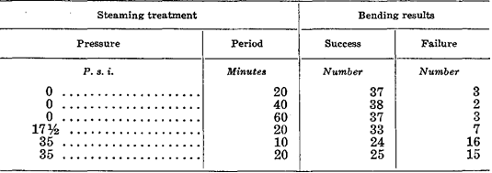
Softening With Steam or Hot Water
Notes:
Despite considerable experimentation with various chemical treatments, plasticization with steam or hot water remains the most practical and satisfactory method of softening wood for bending purposes. Water alone softens wood somewhat, as evidenced by the fact that greenwood bends more readily than dry wood. Likewise, heated wood is more readily bent than cold wood. Together, heat and moisture can produce a degree of plasticity roughly 10 times that of dry wood at normal temperatures.
In general, hardwoods are more readily softened than softwoods, and certain hardwoods are more so than others. The degree of softening is one index of bending quality. It is rarely, if ever, necessary to soften wood to its maximum degree of plasticity for bending purposes. Indeed, excessively softened wood may fail sooner than wood that is not so soft; presumably, softening weakens the wood. Evidence of the effects of over-plasticization is found in the results of Forest Products Laboratory tests on the steaming of white oak was presented in the table.
In table can be noticed the effect of steaming pressure and time on endwise compression values of 1 ½- by 1 ½ by 3-inch specimens of Wisconsin- grown red oak.
In table can be notce the bending results for 1- by 2-inch specimens of Wisconsin grown white oak, steamed at different steam gage pressures for various lengths of time and bent to 2 ¼-inch radius where the moisture content of wood before treatment was 25 percent.
The results in table indicate that steaming at 35 pounds gage pressure for as short a period as 10 minutes is detrimental. Although steaming at 17½ pounds gage pressure caused more bending failures than steaming at 0 gage pressure, the number was not significantly greater from a statistical standpoint. The increase in the number of failures, however, indicates that steaming at 17½ pounds gauge pressure may be disadvantageous. All the specimens steamed at 0 gage pressure bent equally well, indicating that steaming at this pressure for as long as 1 hour had no harmful effect.

Slide 6
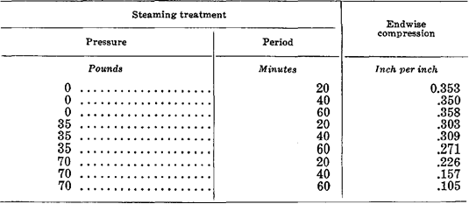
Effect of steaming pressure and time on endwise compression values
Notes:
In other experiments, the effect of steam pressure on bending was measured by the total endwise compression steamed wood will assume before failing. Steaming at 0, 35, and 70 pounds gage pressure had an increasingly adverse effect on the amount of endwise compression that the wood could take before failing. Longer steaming periods at 35 and 70 pounds gage pressure also lowered the amount of compression the wood could take.
The moisture content of wood before treatment was 26 percent. The temperature of saturated steam at atmospheric pressure, about 212° F., is generally sufficient to plasticize wood for bending. This is an advantage in several respects. The use of steam at atmospheric pressure eliminates the need for expensive high-pressure retorts. It is easier to obtain saturated steam within a closed retort or steam box when the steam is injected at low pressure.
High-pressure steam becomes superheated and “dry” when released from pressure because the pressure is lost more rapidly than temperature. The operation of a retort or steam box is simpler with steam at zero or low-gage pressure. With high-pressure steam, the steam valve must be closed and some time allowed to elapse before the door of the retort can be opened, thus delaying operations. One type of low-pressure retort is designed so that opening the door closes the steam valve and closing the door opens the valve. This arrangement speeds operations and reduces the possibility of a loss of moisture from the surface of the steamed stock while the steam is off.
Steam should be injected into a retort through water standing in the bottom so that the steam within the retort will be saturated or wet. If the steam is not injected through water, the retort should be designed so that a certain amount of condensate accumulates on the bottom before running into the drain. The line leading from the boiler to the retort should contain wet or saturated steam, and a run of uninsulated pipe near the retort will also help maintain wet steam in the retort.
Treatment of wood with boiling or nearly boiling water is approximately equivalent to saturated steaming at atmospheric pressure. Boiling water is more convenient when only a portion of a stick needs to be plasticized. It is often necessary to add moisture to wood, particularly to the surfaces, during the plasticizing process. If the stock has a moisture content of 20 to 25 percent, no additional moisture is needed, even for severe bends. At 15 -percent moisture content, it is probable that no additional moisture is needed for making moderate bends. However, additional moisture is needed in the surface zones for severe bends.
To make relatively dry stock (12 percent or less) plastic enough for moderate or severe bends requires that moisture be added during the heating process. Most of the added moisture is absorbed by the surface zones. Since the concave surface must assume the maximum compressive strain, it needs optimum plasticity induced by sufficient heat and moisture. Dry wood should be both heated and moistened, but wet wood need merely be heated.
Bending stock selected from general-use lumber is probably too dry for satisfactory bending. To increase its moisture content and avoid long steaming periods, the dry stock should be soaked in water for several days. The pieces should be end coated to prevent excessive absorption by exposed end grain.
The required steaming or boiling period varies. Wet stock can be steamed for a shorter period than dry stock. Stock to be bent to a mild curvature can be steamed for a shorter period than stock to be bent to a severe curvature. Different species probably become plastic at different rates, and therefore some species may need longer steaming periods than others. As a general rule, the wet stock should be steamed or boiled for ½ hour per inch of thickness and dry stock 1 hour per inch of thickness.
There is some danger of over steaming or overboiling stock, but when the steaming is done at atmospheric pressure, the danger is not great. According to table, stock steamed at 0 gage pressure for 20, 40, and 60 minutes produced about the same number of successful bends, 37 out of 40. Similar stock with a moisture content of 15 instead of 25 percent produced 29, 35, and 37 successful bends out of 40 after steaming at 0 gage pressure for 20, 40, and 60 minutes, respectively. For similar bending results, stock at a moisture content of 15 percent needed a steaming period of 60 minutes, while stock at 25 -percent moisture content needed only 20 minutes.
In commercial bending, the plasticizing treatments should be coordinated with other bending operations. The retorts or steam boxes should have sufficient capacity to keep the bending apparatus in continuous operation. Individual retorts should be small enough to allow rapid unloading so that the surfaces of the steamed stock do not dry before it can be placed in the bending machine. Numerous small retorts also allow more flexibility in adjusting steaming periods to the thickness and character of the stock. For efficient
operation, the capacities of the retorts and machines should be SO balanced that the time required to load, steam, and unload the stock from the retorts is correlated with the time required to load, bend, and unload it from the bending machines. Under such conditions, the steamed stock can be placed in the machine and bent with minimum delay.
Since moisture diffuses more rapidly along than across the grain of the wood, the ends of the bending stock absorb more moisture during the steaming or boiling treatment. Such pieces may end check during the drying and fixing process. Overly wet ends are also easily mutilated by the devices applying end pressure. A moisture-resistant coating applied prior to the plasticizing treatment will reduce the absorption of moisture at the ends and minimize the hazard of checking and mutilation.

Slide 7
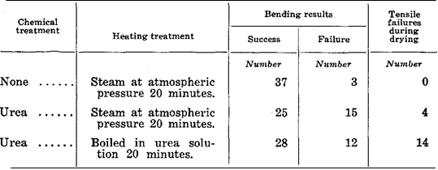
Plasticizing With Chemicals
Notes:
Certain chemicals, such as urea, urea -aldehyde, tannic acid, and glycerin, have been tried as wood plasticizers. It has been found that soaking wood in tannic acid solution has no important effect on plasticity. Experiments at the Forest Products Laboratory using glycerin as a plasticizer failed to yield favorable results. Treatments with urea alone or together with formaldehyde or dimethyl urea cause wood to become highly plastic. The effect pro- reduced by urea alone is the most marked. Urea causes wood to become thermoplastic, in which state it can be bent when hot even though the moisture content is low. Urea-treated stock does not bend so well and is weaker than, stock plasticized by steam. The number of successful bends and failures in bending, and tensile failures in drying to fix the bend, in 1 - by 2-inch specimens of Wisconsin-grown white oak where the moisture content of wood before treatment was 25 percent was presented in the table.

Slide 8
Bending With End Pressure
a simple bend in a single plane,
a re-entrant or S type of bend in a single plane,
a compound bend in more than one plane.
Notes:
For most bending, end pressure is necessary to obtain the required compression and prevent tensile failures. End pressure can be applied in several ways, but the most common is by means of a metal strap with end fittings, such as end blocks or clamps. The metal strap is placed against the convex side of the stick to absorb tensile stress that would normally be absorbed by the wood. If the strap can be made to operate with 100 -percent efficiency, no tensile stress is present in the wood, and the whole stick is subjected to compressive stress.
In actual practice, it is improbable that the metal strap often absorbs all the tensile stress. The convex face of the stick is therefore subject to slight tensile stress and is stretched slightly in the lengthwise direction. Unless a tensile failure develops, this stretching is advantageous because it reduces slightly the amount of compressive deformation required on the concave side. To make a successful bend, the wood must be distorted without developing visible failures either in tension or in compression. Moderate to severe bends, which require end pressure, can be divided into three general classes:
1. a simple bend in a single plane;
2. a re-entrant or S type of bend in a single plane
3. a compound bend in more than one plane.

Slide 9
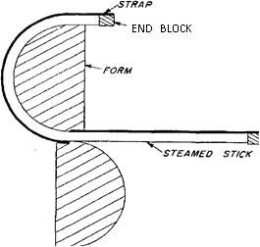
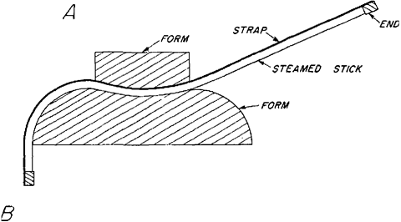
a) an S
b) a re-entrant bend in wood.
a)
b)
Notes:
The different classes of bends require different methods of strapping and bending and of restraining while drying and fixing. A simple bend in a single plane may be made by hand, in a hot-plate press, or in any type of bending machine. The pieces may be bent singly, in groups, or in multiple widths to be sawed later. The strapping of a simple bend in a single plane is relatively easy. The strap is continuous from end to end and is in contact with the convex side of the stock. The strap is either equipped with end blocks to apply pressure to the ends of the stick or clamped to the piece at the ends or at points beyond the curve. Provision may be made for adjusting the distance between the end blocks or for regulating the amount of end pressure applied. When slender pieces are bent, a means of reducing the amount of end pressure applied is necessary to avoid buckling of the unbent part during bending.
The re-entrant and S types of bends consist of several simple bends reversing in direction. Since the convex and concave sides of the stick are interchanged as the bend reverses, multiple straps are needed. For only one reversal of curvature, the straps are fastened to the form or table at the inner portions of the form and are equipped with end blocks at the outer extremities. Such bends are generally made by hand, one at a time, with the straps, arranged so that they function on the convex side of the section being bent. The best pieces are then clamped to the forms and dried and fixed. A diagrammatic sketch of the bending apparatus for making was presented in figure 4.
On that figure can be specified: a) an S and; b) a re-entrant bend in wood.
Compound bends, which are in two or more planes, are made with a complicated system of devices for applying end pressure. Bends of this nature are made by hand by highly skilled workmen. The general scheme is to complete one part of the bend, clamp it to the form, and proceed to the next part, constantly manipulating straps and end blocks to maintain the required end pressure at all times. The piece is bent to a metal form and must be dried and fixed while fastened to the form.
The actual bending technique, although subject to minor variations with the different classes of bends, has more or less general established features. After the plasticizing treatment, the stock should be placed in a position for bending with as little delay as possible. In some types of equipment, the strap and end-block assembly automatically locate the piece with respect to the form. Some bending apparatus is designed so that the strap and end -block as- simply hold the stock in position, preventing it from shifting on the form. In other machines, the fixed end of the stock must be clamped to the form or some device employed to hold the stock near the midpoint of the form.
The stock should fit snugly against the end blocks before bending is started. This can be accomplished by equipping the end block with a screw and bearing plate that is screwed tight or by inserting wood or metal shims between the stock and the end block. Some clearance between the end of the stock and the end block may be permissible in the early stages of bending. After bending starts, this clearance will soon disappear, and the end blocks will come into play. Generally, however, some end pressure should be applied at the very start of bending. When a number of pieces are bent together in a common strap and end-block assembly, they must be cut to a uniform length so that each will bear its share of the end pressure. Shimming individual ends is time-consuming.

Slide 10
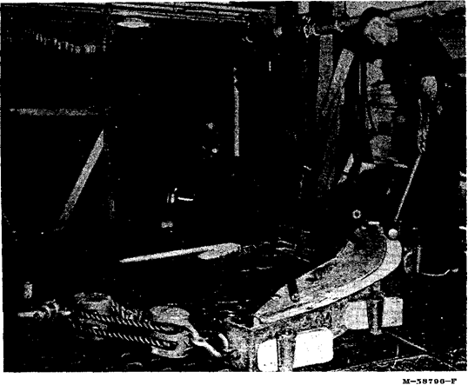
Bending a boat rib by pulling one end around the form and holding the bent part against the form by means of dogs and wedges.
Notes:
The bending load should be applied slowly so that the plasticized wood will be distorted more or less uniformly along its length. In some apparatus, such as hot-plate presses, the stock is prevented from backing away from the form during bending by the machine itself and the character of the imposed forces. In other types, it is necessary to hold the bent portion of the piece in contact with the form. In bending such heavy pieces as boat parts, for example, it is generally necessary to apply force to the portion already bent to keep it in contact with the form. The bending slab or table is equipped with holes for pins or dogs that are used along with wedges or screws to force the piece against the form and prevent it from backing away. The bending of a boat rib by pulling one end around the form and holding the bent part against the form by means of dogs and wedges was presented in figure.

Slide 11
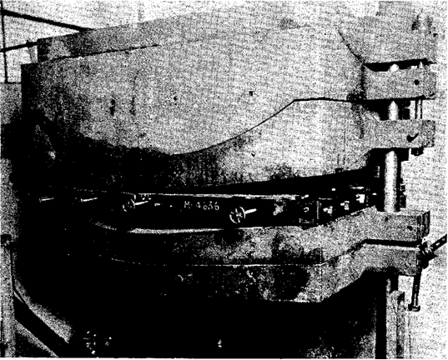
A hot-plate press for bending parts.
Notes:
If end blocks are equipped with a screw and a bearing plate, it is customary to release the end pressure to some extent as bending progresses. This operation is particularly necessary when a reverse bend or buckle starts to form in the still unbent portion of the piece. The reverse bend is more likely to occur in slender pieces. Reverse bends can be eliminated by equipping the end blocks with reversed levers that extend back as far as the last point of contact between the wood and the form. Although releasing the end pressure during bending may reduce slightly the chance of compressive failure, it invites tensile failure. Even though it has been widely recommended in the past, there is some question concerning the need for releasing end pressure as the bending progresses, except to relieve the tendency to buckle or form reverse bends. Measurements of end pressure during bending tests show that this pressure increases up to a certain point and then remains practically constant throughout the rest of the bending process. From a theoretical point of view, the end pressure could remain constant, diminish, or increase during a bending operation, depending on the stress-strain relations developed in the wood.
The pan is equipped with reverse levers and devices for applying pressure to prevent lateral buckling. A hot-plate press for bending parts was presented in figure .
Many devices and machines have been made for bending wood. In some cases, the piece can be bent by hand around a form by means of a strap and a device for applying end pressure. Some machines consist of rollers between which the strips of wood are passed. The diameter and position of the rollers determine the shape of the bend. One hand-powered machine for bending several pieces at once consists of a battery of straps and end blocks fastened to a central steam-heated form. Each piece is placed in its strap and bent to the form until a complete load is obtained. The pieces are left on the form until dried and fixed. For bending, heavy members, such as ship and boat parts, a bending slab or table with the form attached is used. One end of the piece is generally fastened, and the free end is pulled around the form by means of tackle and a power unit.

Slide 12
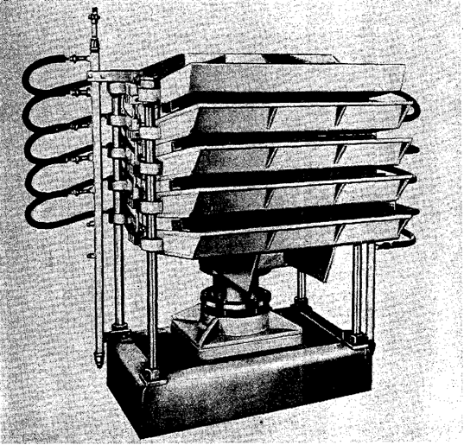
Hot-plate press for bending chair parts.
Notes:
Hot-plate presses, which are widely used to bend furniture parts, consist of hollow metal male and female forms or platens heated by steam. The bending stock is placed between the forms, either with or without a pan for applying end pressure, and the forms are brought against the stock by hydraulic pressure. A mechanical fastening is used to keep the plates in position after closing. The bending pieces are held to shape and dried between the heated plates. Another type of hot-plate press for bending chair parts was presented in figure 7.

Slide 13
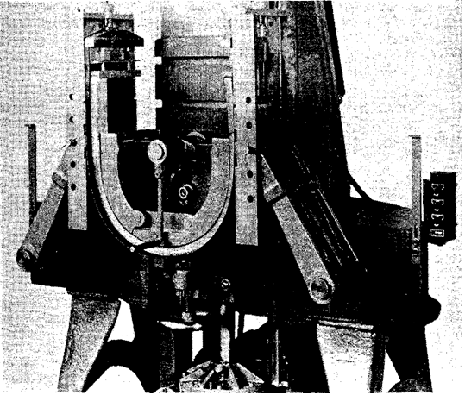
Rim type of bending machine with a chair part bent through an arc of 180°.
Notes:
A machine commonly used to bend several heavy pieces or a larger number of small parts at the same time consists of two heavy arms connected to a heavy strap. As the arms move upward, the heavy steel strap pulls the stock around the form. A minor strap is generally used with this type of machine. When the bend is completed, tie rods are fastened across the ends of the minor strap to permit the removal of the stock from the machine.
A machine for bending rims or rails consists of a horizontal table with a form attached. In some machines, the form and table rotate, winding up the stock. In others, the form and table are stationary, and the stock is bent by fastening one end of the piece and carrying the other end around the form. With both types of machines, a strap and end block are used. Because the stick is slender, the end pressure is released as the bending progresses. If the stock is wound in a single plane, the ends are scarfed beforehand. The Rim type of bending machine with a chair part bent through an arc of 180° was presented in figure 8.

Slide 14
Bending Laminated Members
Notes:
The laminating form to produce curved members is analogous to the production of solid curved members. A straight piece of considerable thickness is built up by gluing together a number of thinner pieces, such as one-inch boards. The laminated member is then bent like a solid piece. The advantages of this method are the easier and faster drying of the thin boards and the opportunity to select the best boards for the faces, particularly the concave ones. However, the glue joints must be good, and the glue must be able to withstand the steaming treatment. Applying Veneer To Improve Bending Quality Wood of poor bending quality can be improved by gluing veneer of good bending quality to the surface that is to be concave. The veneer assumes the maximum amount of compressive deformation and supports the inner surface of the wood.
This method was tested at the Forest Products Laboratory with 1/8-inch birch and Douglas-fir veneer glued to ½-inch sweetgum heartwood of poor bending quality. The specimens of solid sweetgum and sweetgum and veneer, all 5/8 inch thick, were at 20 -percent moisture content when steamed. After steaming at atmospheric pressure for 20 minutes, they were bent under end pressure to a radius of 3½ inches. The bending results was presented in table.
The poor bending quality of the sweetgum (6 successful bends out of 40) was vastly improved when the birch veneer was glued to the compression. face. The Douglas -fir veneer, however, could not assume the required deformation when the grain of the veneer was parallel to the length of the stick. Only one specimen of this group was bent successfully. Douglas -fir veneer glued with the grain perpendicular to the length of the stick improved the bending quality of the sweetgum.

Slide 15
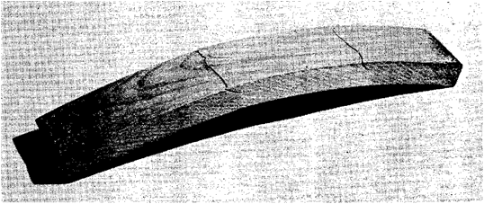
Tensile failures in a chair -back slat bent with insufficient end pressure
Notes:
In a successfully bent piece, the deformation, chiefly compression, is distributed nearly uniformly over the curved portion and consists of myriad minute failures. For the most part, the failures consist of folds or wrinkles in the fiber walls, with perhaps some slippage of the wood elements past each other. The wrinkling is greatest on the concave surface of the piece, and it decreases as the convex surface is approached. If the strap and end blocks have functioned perfectly, the point of zero deformation is at the convex surface. If they have not functioned perfectly, the zero point is slightly below the convex surface, which has assumed some tensile strain.
Failures occur if the plasticized wood is stressed beyond its tensile or compressive limit. In free bending, failures are nearly always in tension, because plasticized wood cannot be stretched more than 1 or 2 percent of its length. If tensile failures occur when end pressure is applied, it is because the strap and end blocks are not exerting sufficient pressure to keep the stretch of the convex side below the limit of 1 to 2 percent. This is the most common type of failure in commercial bending operations, and, as a rule, it is due to poorly designed or worn apparatus or to poor bending technique. Such irregularities as distorted grain, cross-grain, and seasoning checks may contribute to tensile failure. Tensile failures in a slat bent with insufficient end pressure were presented in figure.

Slide 16
Tensile failures
when the plasticized wood is compressed excessively,
when stresses are concentrated because of some defect,
when lines of weakness encourage shear failure.
Notes:
Tensile failures also take the form of small slivers that break away from the convex face during bending. These are generally associated with slight cross grain. If the metal strap is a wide as the stock it helps to prevent slivers from breaking up if it is narrower, slivers may break o upon the edges. A device for exerting pressure against the face of the stock at the point of tangency to the form is helpful in reducing living. Compressive failures occur:
1. When the plasticized wood is compressed excessively;
2. when stresses are concentrated because of some defect;
3. when lines of weakness encourage shear failure.

Slide 17
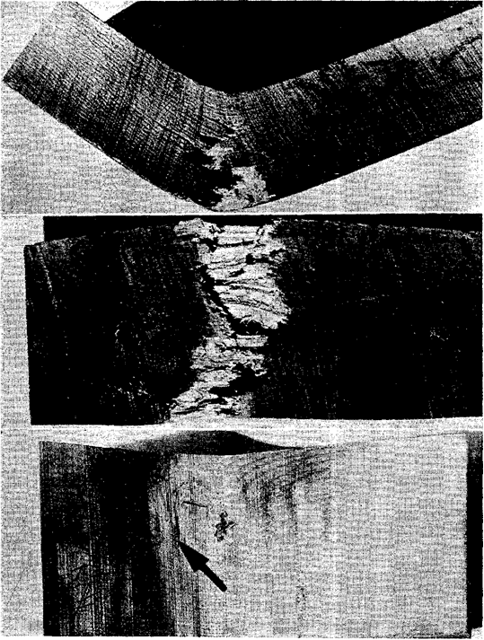
Failure in a bent boat frame
The compressibility of the stock depends on the species of wood used and the plasticizing treatment.
Improper plasticizing treatments also reduce compressibility.
Notes:
The compressibility of the stock depends on the species of wood used and the plasticizing treatment. A species of poor bending quality is severely limited in the number of compressive distortions that it can take without failing. Improper plasticizing treatments also reduce compressibility. Failure in a bent boat frame was presented in the figure.

Slide 18
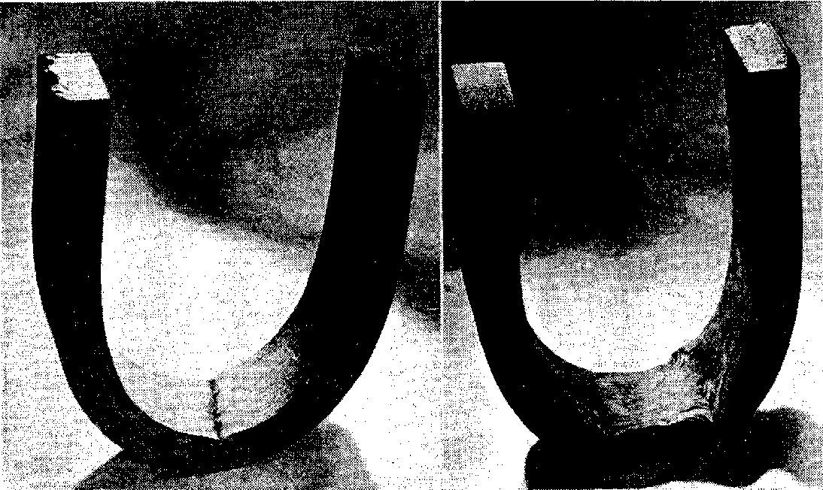
Two types of compressive failure
Notes:
The knot could not be compressed, and the stick developed a sharp kink that caused the outer face to fail in tension. Failure in compression may take the form of a crosswise fold or wrinkle, a longitudinal separation of fibers followed by lateral buckling, or a shear failure roughly along the longitudinal axis of the piece followed by separation of the fibers and buckling. The mildest form of visible compressive failure is a bulge or wrinkle extending from edge to edge on the concave side. Compressive failure may also occur in green stock. The space occupied by the excess water reduces the available void volume and causes hydro-static pressure to develop when the wood is compressed beyond a certain point. The two types of compressive failure was presented in the figure 11.
On that figure can be specified Cross fold or wrinkle (left) typical of wood of poor bending quality or improperly plasticized wood; lateral buckling (right) preceded by shear failure.

Slide 19
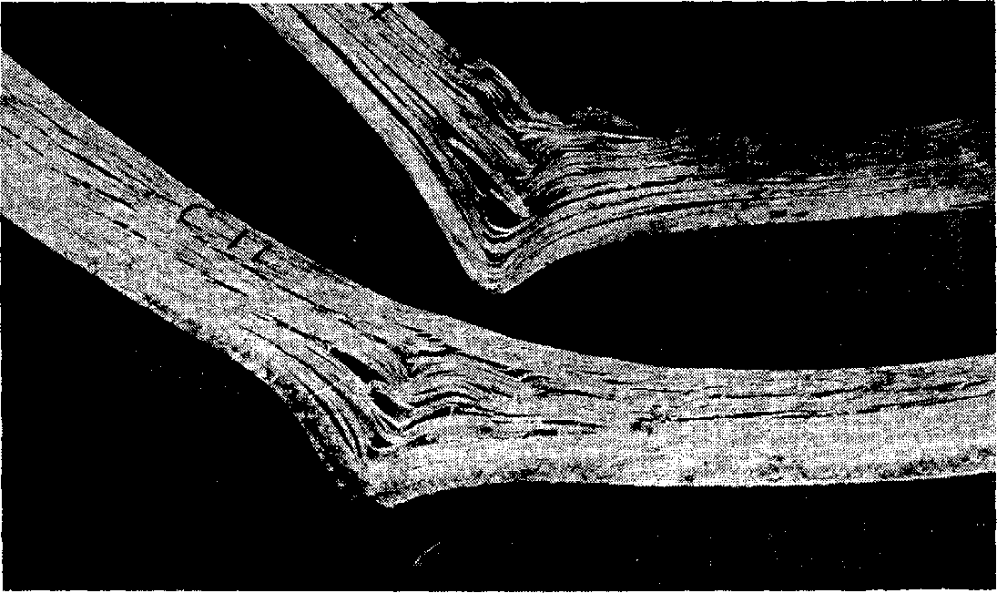
Compressive failures brought about by the presence of surface checks on concave face of stock
Notes:
Compressive failures by lateral buckling in a plane perpendicular to the bend are common in pieces bent edgewise without lateral support. Such pieces are too thin or narrow to act as columns under the compressive stress, and they bend like beams. A similar effect is produced in pieces containing surface checks on the con - cave side. Compressive failures brought about by the presence of surface checks on concave face of stock was presented in the figure.
The surface checks set up lines of shear that, in effect, reduce the wide piece to a series of narrow strips that tend to buckle laterally, as does a single strip bent edgewise. Sur - face checks in combination with either spiral or diagonal grain may cause a sliver -shaped portion to shear from a corner of the piece, particularly if the checks are located near an edge or corner. In making compound curvatures, the twisting of stock at the points where the plane of the bend changes may cause shear failure.

Slide 20
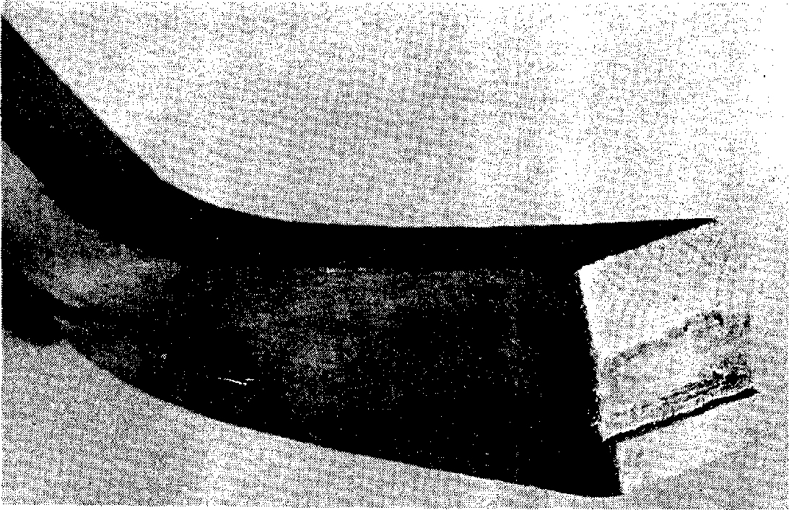
Crushing of the end of a bent chair -back post, caused by improper bearing of the end block
Notes:
Some distortion of cross section during bending is inevitable. As the piece is compressed between the strap, form, and end blocks, it tends to become thinner and wider. Unless restrained, the piece widens most on the concave side, which is in contact with the form. The increase in width is due to the fact that the plasticized wood tends to flow in the direction perpendicular to the lines of force. This increase in width probably provides some of the space needed by the compressed and folded fibers. In cutting or machining stock before bending, allowance should be made for the distortion of cross section during bending. Mutilation of stock during bending occurs principally at the ends. Crushing or splitting of the ends is common, because pressure is not applied uniformly to the entire end surface. Unless end coated, the ends of a steamed piece are often plasticized more than the rest of the piece because of greater absorption and penetration of moisture during the plasticizing treatment. The Crushing of the end of a bent chair -back post, caused by improper bearing of the end block was presented in the figure.

Slide 21
Removal of Discolorations Caused in Bending
Steaming or boiling causes wood to change in color and take on a lifeless appearance
If stain is detrimental to the final product, various protective measures can be taken.
The water in the tank should be replaced at intervals to reduce the amount of iron in it.
Stain resulting from the action of tannic acid and iron can be removed by bleaching after the bent piece is dried and fixed.
Notes:
Steaming or boiling causes wood to change in color and take on a lifeless appearance. This effect is restricted to the surfaces. A more serious source of discoloration is the reaction of extractives in the wood with metal. The reaction of tannic acid and iron gives the most serious discoloration. When hot, wet oak comes in contact with iron, it becomes a dark purplish -black color. This may occur in the steaming retort or boiling tank or in the bending apparatus.
If stain is detrimental to the final product, various protective measures can be taken. The stock should be protected from drip or kept from contact with iron shelves in a retort. Although it is difficult to avoid stain while wood is soaking or boiling in steel or iron tanks, coating the inside of the tank will help. The water in the tank should be replaced at intervals to reduce the amount of iron in it. Paper or cellophane can be placed between the stock and the iron parts of bending apparatus to prevent stain. Iron or steel parts can be galvanized to eliminate most of the staining, although galvanizing is not permanent and will need to be renewed. Straps of spring brass will not stain most woods other than oak, and it only slightly. Stain resulting from the action of tannic acid and iron can be removed by bleaching after the bent piece is dried and fixed. A hot 3% solution of oxalic acid applied to the stained piece will remove the stain. Afterward, the acid solution should be sponged from the piece with clear water. The process may be re - peated several times if necessary.

Slide 22
Repair of Pieces Damaged in Bending
Failures may impair or completely destroy the utility of a bent piece.
If the tensile failure is in the form of a large sliver, it is occasionally feasible to force and fasten the sliver back into place, permitting the member to be used where appearance is not important.
Compressive failures accompanied by buckling and separation of the fibers generally make the piece useless. In chair parts with a hidden concave side, it may be possible to use a member with a rather severe compressive failure.
Notes:
Failures may impair or completely destroy the utility of a bent piece. They weaken it, break the continuity of the surfaces, and impair its appearance. Tensile failures are generally more detrimental than compressive failures. Sometimes, the damage can be repaired.
If the tensile failure is in the form of a large sliver, it is occasionally feasible to force and fasten the sliver back into place, permitting the member to be used where appearance is not important. Boat parts are sometimes repaired in this way. Tensile failures in chair parts are generally cause for rejection of the piece.
Compressive failures accompanied by buckling and separation of the fibers generally make the piece useless. In chair parts with a hidden concave side, it may be possible to use a member with a rather severe compressive failure. The member can be reinforced with corner blocks. Parts with moderate compressive failures consisting of wrinkling and bulging of the fibers without much separation can often be used after the bulges are dressed off. When maxi - mum strength is needed, defective members should not be used.

Slide 23
Drying and fixing (setting) the bend
If a piece of wood is removed from the bending apparatus while still hot and plastic, it tends to straighten or spring back.
To counteract this tendency to spring back, the piece must be held in its bent shape until it has cooled and dried or “set.”
With mild bends, the tendency to spring back is not entirely overcome by cooling and drying.
Bent parts are dried in various ways, depending largely on the intended use.
Chair manufacturers dry bent parts in heated rooms. The temperature within these drying rooms may range from 140° to 190° F.
Notes:
If a piece of wood is removed from the bending apparatus while still hot and plastic, it tends to straighten or spring back. This is a natural reaction of the wood to the release of the compressive stress imposed during the bending operation. This stress is greatest along the concave face of the piece, where some wood has failed and de - formed; along the convex face it actually ceases, and a slight tensile stress may exist even during bending. As soon as the piece is out of the bending apparatus, the tensile stress intensifies, tending to pull it straight. Some compressive stress remaining in the wood along the concave face also tends to straighten the piece. However, the permanently deformed wood along the concave face prevents the piece from straightening out completely.
To counteract this tendency to spring back, the piece must be held in its bent shape until it has cooled and dried or “set.” This is sometimes done by leaving it in the bending apparatus. More often, tie rods or stays are fastened to both ends, and the piece is removed from the apparatus and stored while setting. Or it is clamped to the form and removed from the bending machine. The piece may also tend to elongate slightly with release of end pressure when removed from the bending apparatus. To counter - act this tendency, a minor strap that provides some end pressure is sometimes kept on the piece until it sets, and tie rods are hooked to the ends of this strap.
With mild bends, the tendency to spring back is not entirely overcome by cooling and drying. With such bends, it is customary to overbend somewhat to compensate for the partial spring back. Although cooling and drying both contribute to the restoration of stiffness and the fixing of the bent shape, drying is apparently more important. A piece bent to varying curvature is more difficult to hold in shape. If restrained merely at the ends, it will attempt to assume a uniform curvature. It will therefore require more restraining members. The safest way to dry and fix such a piece is to keep it in the form.
A scheme that has proved helpful in retaining the curvature of bent members during drying and fixing consists of permitting the inner or concave face to dry more rapidly than the outer. This is accomplished by removing the form and retaining the metal strap or by using perforated forms. When the inner face dries first, it sets in an expanded condition along the length of the member. This set will help counteract the tendency of the bent members to close up when the entire piece reaches a low moisture content.
Bent parts are dried in various ways, depending largely on the intended use. Bent parts for boats or ships are sometimes permitted to dry on the framework of the vessel. Ship and boat builders seldom provide special drying rooms, because ship or boat framing members do not require such thorough seasoning as do many other bent parts. Pieces that are bent in hot -plate presses are dried while in the press between the steam -heated plates. The steam pressure may be 20 pounds per square inch or more, which gives a plate temperature of 260° F. or higher. In other types of bending ma - chines, including the steam -heated form, the bent pieces are also dried in the machine.
Chair manufacturers dry bent parts in heated rooms. These rooms may be equipped with thermostats and occasionally with some means of controlling relative humidity. The temperature within these drying rooms may range from 140° to 190° F. Occasionally, bent pieces are dried in ovens at excessively high temperatures. Some bent pieces are dried in the shop by applying concentrated heat in one form or another. Many bent members are permitted to stand in the shop while drying and fixing.

Slide 24
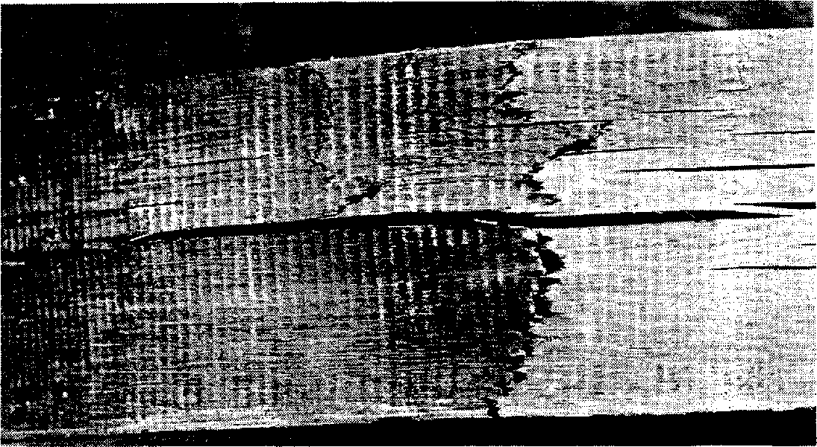
Tensile failures that occurred in a bent boat frame during drying and fixing
Notes:
Several things happen to bent, plastic pieces as they dry. Plasticity is reduced and stiffness increases as moisture are lost, The properties of the wood become more like those of untreated wood, although its original strength is never completely recovered. As the wood loses moisture and plasticity and shrinks, new stresses are set up within the bent piece. The shrinkage in length and thickness causes the bent piece to attempt to take on a shorter radius of curvature. As the thickness decreases, the difference between the length of the convex side and that of the concave side calls for a general curve of a shorter radius. The wrinkled and folded wood on the concave side of the bent piece develops lengthwise shrinkage in drying. This shrinkage exerts tensile stress on the concave side that tends to increase the curvature. If no compression member is placed between the ends or legs of the piece, the tensile stress is transmitted to the convex side and sometimes causes failures. The Tensile failures that occurred in a bent boat frame during drying and fixing were presented in figure.

Slide 25
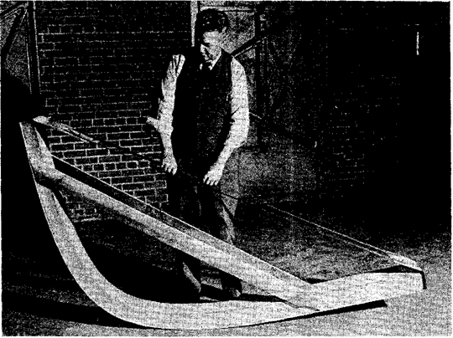
Bent boat member prepared for drying and fixing, showing minor strap, tie rods, and wood stays
Notes:
Such failures can be prevented by applying some end pressure to the bent piece. The bent boat member prepared for drying and fixing, showing minor strap, tie rods, and wood stays were presented in figure.

Slide 26
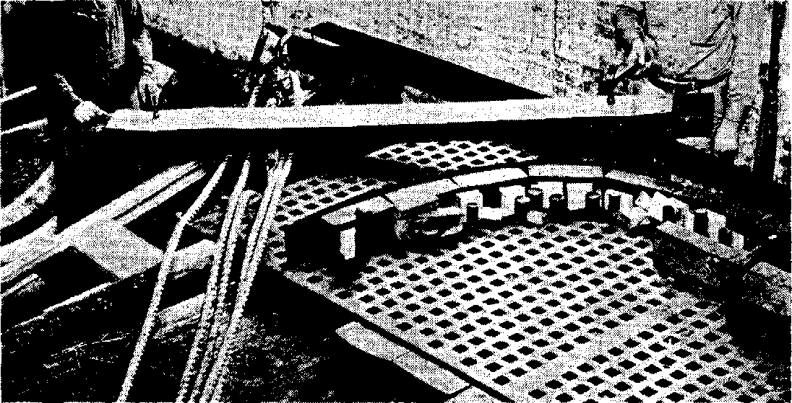
Spikinag minor strap to the outer face of a piece that is to be bent to form a boat rib.
Notes:
The strap will absorb some of the tensile stress during bending and during the drying and fixing process. If a minor strap or the main strap with end fittings is left on the piece during drying, any tensile stress in the convex side is taken up by the strap. A minor strap being fastened on the side that is to be convex was presented in figure.
Pieces dried in a hot-plate press with good bending pans are under end pressure. When no compression member is provided between the ends of the bent pieces, their curvature may be increased so that they are no longer suitable for the intended use. Over drying increases the hazards of tensile failure and distortion of curvature. A drying room with controlled temperature and relative humidity reduce this hazard. Likewise, if the bent pieces are suitably restrained by devices that act both in tension and compression, distortions of curvature are not likely to occur. Drying also causes shrinkage in the width of the piece, which sets up stresses similar to ordinary drying stresses. The greater the loss of moisture during the drying and fixing processes, the greater is the drying stress. The hazards of surface and end checking that were present in the original seasoning are present to a lesser degree in the drying of bent stock. The surface of wood seasoned to a moisture content of 15 to 20 percent is generally set in compression. In such a state, the wood is able to withstand exposure to severe drying conditions without developing fresh checks. The steaming or boiling treatment given wood before it is bent may, however, relieve this surface set and enable the surface to go into tension in the lateral direction when the bent piece is dried. Under such conditions, surface checks may develop in the drying and fixing process.
Stock steamed and bent at a high moisture content is more likely to develop surface and end checks during the drying process than stock steamed and bent at lower moisture content. In a furniture factory, oak and beech parts steamed and bent at a relatively high moisture content surface checked during drying. The drying room was maintained at a temperature of 170° F., with no control of relative humidity. In the case of oak chair-back posts bent in a hot-plate press and dried between plates heated by steam at 20 pounds gage pressure, the percentage of pieces rejected because of checks increased rapidly with an increase in the moisture content of the bending stock. Pieces dried in hot-plate presses are highly susceptible to end checking, particularly when the ends have absorbed considerable moisture during steaming or boiling. End coatings reduce end checking.

Slide 27
Conditions for Drying Bent Stock
The temperature and relative humidity of the drying room should therefore be suitable for all of the best stock. Temperatures of 140° to 160° F.
Bent pieces in furniture and chair factories generally are left in the drying rooms for 24 to 72 hours.
Oak steamed and bent in the green condition becomes set even before it dries to the fiber saturation point (about 30 -percent moisture content).
Notes:
In a commercial bending operation, a variety of bent members of different species and thicknesses may be produced, perhaps with variations in moisture content. Since it is impractical to have numerous drying rooms in order to obtain optimum drying and setting conditions, all of the best pieces are placed in 1 or 2 rooms. The temperature and relative humidity of the drying room should therefore be suitable for all of the best stock. Temperatures of 140° to 160° F., with no moisture added to the air, are generally satisfactory unless the members happen to be particularly large, of a species difficult to season, or at a high moisture content.
The length of time that bent members need to remain in the drying room depends on the adequacy of air circulation, the thickness and moisture content of the stock, and the desired final moisture content. Bent pieces in furniture and chair factories generally are left in the drying rooms for 24 to 72 hours. A common practice is to leave them until the restraining device across the ends becomes slack. The pieces will no longer spring back when the restraining device is removed.
The time required to reach the moisture content needed to fix the bend is usually much shorter than that required to reach a moisture content suitable for service. The amount of time or drying necessary to fix a bend varies with the species of wood and the type of bend. Oak steamed and bent in the green condition becomes set even before it dries to the fiber -saturation point (about 30% moisture content). If a bent member is dried to a moisture content suitable for service, the bend is certain to be fixed.

Slide 28
Behavior of Bent Members
It is generally considered that the curvature of a bent member is permanent after it has been dried and fixed. Such is not the case, because changes in moisture content set up stresses that change the curvature.
The effect of the shrinking or swelling in length and thickness is cumulative. With shrinkage, the curvature is increased.
Specimens of the same material steamed at 15% of moisture content and bent to a radius of 2 3/8 inches behaved in the same manner but with even greater changes in curvature.
Although neither set of these specimens maintained its curvature under changes in moisture content, the stock steamed and bent at the higher moisture content changed less in curvature with later fluctuations in moisture content.
Notes:
It is generally considered that the curvature of a bent member is permanent after it has been dried and fixed. Such is not the case, because changes in moisture content set up stresses that change the curvature. The various zones through the thickness of the piece differ in the extent of deformation and in the amount of longitudinal shrinkage and swelling they will undergo with a change in moisture content. In addition, shrinking and swelling in thickness tend to alter the curvature of the piece. The wrinkled and folded fibers on the concave side, which have been considerably compressed in bending, shrink and swell appreciably in the lengthwise direction. At the same time, the convex side undergoes negligible lengthwise shrinking and swelling.
The effect of the shrinking or swelling in length and thickness is cumulative. With shrinkage, the curvature is increased. With swelling, the curvature is reduced as the piece tends to straighten. Red oak specimens, 1 inch thick, steamed at a moisture content of 25% and bent to a radius of 2 5/8 inches were dried to a moisture content of 8 percent. After the distance between the legs was measured, the bent specimens were brought to a moisture content of 21 percent. At this moisture content, the legs were more than twice as far apart as at 8 percent. When redried to 8%, the legs were still 60 percent farther apart than originally.
Specimens of the same material steamed at 15 % of moisture content and bent to a radius of 2 3/8 inches behaved in the same manner but with even greater changes in curvature. When the moisture content of these specimens was raised from 8 to 12 per - cent, the distance between the legs was increased by 20 percent. When the moisture content was increased to 22 percent, the distance between the legs was 2½ times that at 8 percent. When redried to 8% of moisture content, the legs were more than twice as far apart as they were originally when at the same moisture content.
Although neither set of these specimens maintained its curvature under changes in moisture content, the stock steamed and bent at the higher moisture content changed less in curvature with later fluctuations in moisture content. It is evident that a bent piece of wood cannot be expected to retain its curvature unless it is held at a constant moisture content or is firmly fastened to other members of the structure.

