Slide 1
Steaming and curving solid wood
Module 3
WULS
Warsaw, 1st December 2021
Notes:
In this module was prepared as part of the All Hands On Deck (AHOD) project, activity IO2A3.
The substantive transmission of the manual is the absolute minimum of sailing knowledge necessary to build a small boat in workshop conditions.
This portion of the message should be assimilated by every hobbyist of sailing.
This is also what every enthusiast of this sport should know to understand roughly the principles of sailing boat construction.
Every sailing enthusiast should improve their skills, looking for the best technique for building their dream boat.
This can be learned in two ways: either through painstaking practice or from public experience. For those who prefer the desire to acquire reliable knowledge over to the written word, further chapters are intended.

Slide 2
Unit 2. Knowing methods of making wooden curves elements for ships and boats
2 hour
Notes:
In this unit the knowing methods of making wooden curves elements for ships and boats will be presented.

Slide 3
Wood bending
criteria for selection of bending stock,
better methods of seasoning and plasticizing wood for bending,
more efficient machines for the bending operation,
techniques for drying and fixing the bent part to the desired shape,
the effect of bending on the strength properties of wood.
Notes:
There are two broad classes of bends, those made without end pressure (free bends), and those made with end pressure. Free bending is feasible only for slight curvatures where the upset, or difference in length between the outer and inner faces of the bent piece, is less than 3 percent. Basket rims and hoops are made by a free-bending process. Boat frames and planking are often steamed or boiled and then bent when installed on the boat by being forced into position and fastened to other framing members. Thin strips for other products are also bent without end pressure.
Of course, wood can be bent to a slight curvature without a plasticizing treatment. When it is steamed before being freely bent, however, the advantage is taken of the fact that heat and moisture affect the stress-strain relation to a greater extent in compression than in tension. This makes it possible for the concave side to assume a certain amount of compressive strain before enough - tensile strain is developed to cause failure in the fibers of the convex side. In bending of this nature, it may be advantageous to over-plasticize the wood, thereby reducing the stress-strain value in compression. Rails, slats, and pickets are often bent in a hot-plate press without applying any end pressure. Bends made by the intrusion, or by forcing the stick or dowel into and through a split mold, are generally made without applying end pressure other than that obtained by friction.
Free bends are not highly permanent, even after drying and fixing, since the deformation obtained during bending is relatively slight. Consequently, it may be necessary to overbend slightly. To retain the curvature, it is usually necessary to fasten the ends of the strip together, as in a hoop, or to fasten the curved piece to other members of the structure. Some free-bent members, such as chair parts, are required to retain their curvature without restraint from other members.
Wood bending is an ancient craft that is of key importance in many industries today, especially in those that manufacture furniture, boats and ships, agricultural implements, tool handles, and sporting goods. Of the several methods commonly used to produce curved parts of wood, bending is the most economical of material, the most productive of members of high strength, and perhaps the cheapest.
Long experience has evolved practical bending techniques and skilled craftsmen to apply them. Yet commercial operations often sustain serious losses because of breakage during the bending operation or the fixing process that follows. There is a long felt need for more reliable knowledge about:
1. Criteria for selection of bending stock.
2. better methods of seasoning and plasticizing wood for bending.
3. more efficient machines for the bending operation.
4. techniques for drying and fixing the bent part to the desired shape.
5. the effect of bending on the strength properties of wood.

Slide 4
The process of wood bent
It is common knowledge that a very thin strip of wood can be easily bent with the hands to quite sharp curvature.
When a piece of wood is bent, it is stretched, or in tension, along the outer (convex side of the bend and compressed along the inner (concave) side.
Plasticized wood can be compressed considerably but stretched very little.
Notes:
It is common knowledge that a very thin strip of wood can be easily bent with the hands to quite sharp curvature. Thin veneers are bent by hand and held in place by weaving them together or attaching them to other parts. Such bending is done without treating the wood. In bending thick pieces of solid wood, however, softening with steam or hot water or plasticizing with chemicals is essential.
When a piece of wood is bent, it is stretched, or in tension, along the outer (convex side of the bend and compressed along the inner (concave) side. Its convex side is thus longer than its concave side. This distortion is accompanied by stresses that tend to bring the bent piece back to its original straightness. The purpose of softening wood with moisture and heat or plasticizing chemicals is to restrict the development of these stresses.

Slide 5
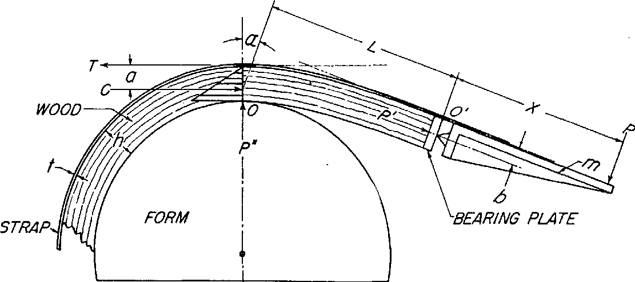
Diagrammatic sketch of the mechanics involved in wood bending under end pressure
(Device: A tension strap and an end block equipped with a pivoted bearing.)
Notes:
Plasticized wood can be compressed considerably but stretched very little. The objective in bending, therefore, is to compress the wood while restraining the stretching along the convex side. Although various devices are used to accomplish this, the most efficient yet found by the Laboratory is the tension strap, complete with end fittings such as end blocks or clamps and a reversed lever. Diagrammatic sketch of the mechanics involved in wood bending under end pressure (Device: A tension strap and an end block equipped with a pivoted bearing.) was presented in Figure.
The figure illustrates what happens when wood is bent. Since X, representing the length of the end fitting, is a constant, the load P must also remain constant. However, P cannot remain constant, because as the stick is bent, the lever arm L + X becomes shorter. Therefore, P must be increased as the bending progresses. The resistance of wood to bending forces at the point of contact of the stick and the bending form, point 0, is approximately constant at all times as bending proceeds. In effect, the unbent part of the stick is a lever and point O a fulcrum as bending force is applied. As this lever arm, represented by the distance L + X, becomes shorter, the bending load ( P ) needs to be increased. At the same time, however, the resistance to end pressure, represented by P', is also constant, and as a result, PX must remain constant.
If P increases, PX increases, and the end pressure is thereby in - creased. Since the resistance to end pressure, P', remains constant, the increased end pressure must result in crushing of the end of the piece or in back bending or buckling. As a result, either too much end pressure is applied during the late stages of bending or too little during the early stages.
In spite of these shortcomings, apparatus of this type may produce successful bends, particularly bends with a small angle of curvature. A common fault of much commercial bending apparatus is in the lever arm that extends beyond the end block. If the lever arm to which the bending force is applied is relatively short, the moment that resists rotating or overturning of the end block may be too small. In such cases, it is impossible to keep the whole stick in compression even when bending to a small angle of curvature.

Slide 6
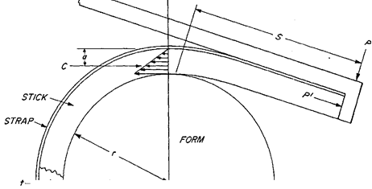
Notes:
A simple device that automatically compensates for the higher end pressure induced by increased bending loads is a reverse lever which was presented on the figure.
This device exerts pressure on the convex face of the stick, and so prevents the end block from overturning. Preventing the overturning of the end block assures the application of end pressure. Because the pressure against the block is generated by the stick itself as it is bent, the force required to make the bend has no effect on the amount of end pressure thus generated.
The reversed lever must extend back as far as the last point of contact between the wood and the form in order to regulate end pressure and prevent reverse bending near the end of the stick. If the stick need not be bent throughout its length, the reversed lever will produce an almost uniform end pressure during the bending operation. With this device it is unnecessary to use a pivoted bearing.

Slide 7
Selecting bending stock
The selection of a species of wood to use in a manufactured product containing a bent member of slight to moderate curvature is largely governed by suitability and availability of the species for the product.
If the curvature is to be severe, however, the species of wood must be selected primarily for its bending quality.
As a rule, the bending quality of hardwoods is better than that of softwoods, and the latter are seldom used in bending operations.
Notes:
The selection of a species of wood to use in a manufactured product containing a bent member of slight to moderate curvature is largely governed by suitability and availability of the species for the product. If the curvature is to be severe, however, the species of wood must be selected primarily for its bending quality.
The bending quality of wood varies widely not only among the different species but also within the same species. Insufficient data are available, however, to permit the listing of species in the exact order of their bending qualities. As a rule, the bending quality of hardwoods is better than that of softwoods, and the latter are seldom used in bending operations. Yew and Alaska - cedar are exceptions ; Douglas-fir, southern yellow pine, northern and Atlantic white -cedar, and redwood are often bent to moderate curvature for ship and boat planking.

Slide 8
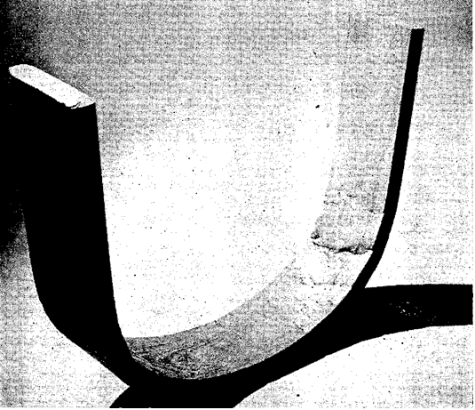
Bending elm wood
A bent chair part of elm containing incipient decay.
The impaired strength properties caused the piece to develop compressive failures in the form of abrupt wrinkles during bending.
Notes:
Stevens and Turner rated a few American species of known good bending quality in the following descending order: white oak, yellow birch, and white ash. Mahogany from Central America was rated as having moderately good bending quality and as superior to khaya, “African mahogany,” in this respect. These ratings are based on the radius of curvature for steamed 1 -inch material at which breakage does not exceed 5% when the wood is bent under end pressure. Numerous hardwood species were ranked at the United States Forest Products Laboratory on the basis of the percentage of breakage sustained during a uniform bending test made without end pressure. These species, in descending order of bending quality, were as follows: Hackberry, white oak, red oak, chestnut oak, magnolia, pecan, black walnut, hickory, beech, American elm, willow, birch, ash, sweetgum, soft maple, yellow -poplar, hard maple, chestnut, water tupelo, cottonwood, black tupelo, mahogany, American sycamore, buckeye, and basswood. The species commonly used in industry for making bent members are White oak, red oak, elm, hickory, ash, beech, birch, maple, walnut, mahogany, and sweetgum.
An extensive study of woodcuts from 20 white oak trees grown in four different localities in Ohio and Kentucky revealed that the bending quality of wood from the four localities varied. And, in most cases, the bending quality of the woodcut from trees in the same locality also varied. An attempt was made to correlate bending quality with specific gravity, rate of growth based on the number of growth rings per inch, end pressure developed during bending, and standard toughness values. No good correlation was found. In fact, the wood of the highest bending quality was almost identical to that of the lowest bending quality in specific gravity and rate of growth.
Despite the fact that little correlation has been found between basic physical properties and bending quality, stock can be selected with reasonable assurance that it will bend without undue breakage.
The principal precaution is avoidance of stock that contains strength reducing defects. These defects are decay, cross-grain, knots, shake, pith, surface checks, and brash wood. Even wood containing incipient decay fails under slight tensile stress and cannot be compressed nearly so much as normal wood. A bent part of elm containing incipient decay. The impaired strength properties caused the piece to develop compressive failures in the form of abrupt wrinkles during bending was presented in the figure.
Straight-grained wood is much less likely to fail during bending than cross-grained wood. The grain should slope not steeper than 1 inch in 15 along the length of the piece. Local cross-grain is also to be guarded against; it is weak under bending loads. Knots are objectionable because they are invariably accompanied by a distorted grain and also because they resist compression.
Shakes, which are longitudinal separations parallel to the annual rings, are responsible for failures in shear during the bending operation. Pith introduces similar lines of weaknesses. Surface checks, which are cracks perpendicular to the annual rings, are likely to cause compressive failures if on the concave side of the piece. On the convex side, they are not so detrimental. Surface
checks in combination with cross-grain are likely to cause pyramid-shaped pieces to be forced out of corners that are in compression and slivers out of corners subjected to slight tension. Exceptionally lightweight wood is likely to be brash and fail during bending. Even if it is bent successfully, it may not have the necessary strength in service. Minor defects in the wood, such as small pitch streaks, burls, and small checks, are permissible if they are located beyond the part to be bent or on the convex side of either mild or severe bends. They may be allowed on the concave side of mild bends, but with severe bends, such defects cause concentration of stresses and compressive failures are likely to result.

Slide 9
Seasoning bending stock
From the standpoint of the bending operation alone, most curved members can be produced from green stock.
Forest Products Laboratory research shows that the optimum moisture content for bending southern oak back posts in a hot-plate press is 12 to 15 percent.
Ideally, bending stock should be air-dried to the desired moisture content, generally 12 to 20 percent, and stored under controlled conditions and temperature of 70° to 80°F.
Notes:
From the standpoint of the bending operation alone, most curved members can be produced from green stock. However, the moisture content of bending stock should also be suitable for the drying and fixing of the bend and for the drying process needed to bring about a moisture content suitable for the finished product. If it is not, the wood is likely to check, split, and shrink excessively. For these reasons, green or partly seasoned stock is not suitable for many bent items.
On the other hand, dry wood is not sufficiently plastic to bend well even when heated to a high temperature. Most kiln-dried lumber is not suited for bending unless it is steamed or boiled enough to absorb the moisture needed to make it sufficiently plastic to bend well. Soaking it in water before it is steamed or boiled is helpful.
To avoid both drying troubles with wood that is too green and bending difficulties with wood that is too dry, the stock should be seasoned to a moisture content that is optimum for the bending method and angle of curvature. For example, in hot-plate press bending, where the curvatures are relatively mild and the drying conditions severe, the optimum moisture content for the bending stock is lower than that for stock bent over forms by hand or machine. Forest Products Laboratory research shows that the optimum moisture content for bending southern oak back posts in a hot-plate press is 12 to 15 percent. For curved rails and slats of less severe curvature than curved posts, the optimum moisture content for bending in a hot-plate press is probably 12 percent. For furniture parts bent over forms, stock at a moisture content of 15 to 20 percent is preferred.
Ideally, bending stock should be air-dried to the desired moisture content, generally 12 to 20 percent, and stored under controlled conditions. A temperature of 70° to 80° F. and relative humidity of 80 percent will maintain wood at a moisture content of 15 to 16 percent. At the same temperature and relative humidity of 65 percent, wood will remain at a moisture content of about 12 percent.
If bending stock is cut to length before drying, an end coating should be used to reduce end checking and splitting, The coating will prevent excessive absorption of moisture by the ends during the steaming process. It will also minimize the tendency to end check and split during the drying and fixing process.

