Slide 1
Steaming and curving solid wood
Module 3
WULS
Warsaw, 1st December 2021
Notes:
In this module was prepared as part of the All Hands On Deck (AHOD) project, activity IO2A3.
The substantive transmission of the manual is the absolute minimum of sailing knowledge necessary to build a small boat in workshop conditions.
This portion of the message should be assimilated by every hobbyist of sailing.
This is also what every enthusiast of this sport should know to understand roughly the principles of sailing boat construction.
Every sailing enthusiast should improve their skills, looking for the best technique for building their dream boat.
This can be learned in two ways: either through painstaking practice or from public experience. For those who prefer the desire to acquire reliable knowledge over to the written word, further chapters are intended.

Slide 2
Unit 4. Acquiring knowledge about cutting and gluing wood and wood-based materials to obtain curvilinear elements
2 hours
Notes:
This unit is about acquiring knowledge about cutting and gluing wood and wood-based materials to obtain curvilinear elements.
All data will be presented in the next slides.

Slide 3
Types of saws and their use
Notes:
Dividing the wood into parts can be done with hands or power saws.
The most universal handsaw that can be used in woodworking is the frame saw shown in Figure.
On the picture types of saws and their use:
a) frame saw; b) payer; c) ridge; d) hole saw

Slide 4
The hacksaw blades toothing
curb - for cutting along the fibers,
tenon - designed to make joinery connections,
guide bar - for making cuts with a smooth kerf across the grain,
rickets - for cutting holes and curves
Notes:
The hacksaw blades have different toothing depending on whether they are for roughing or fine cutting. The most commonly used frame saws, depending on the saw blade attached, are:
1. curb - for cutting along the fibers,
2. tenon - designed to make joinery connections,
3. guide bar - for making cuts with a smooth kerf across the grain,
4. rickets - for cutting holes and curves

Slide 5
Blades for frame
panel (Figure b) - for cutting wide lumber,
ridge (Figure c) - for accurate sawing in order to obtain smooth,
hole saw (Figure d) - for cutting out curved contours.
Notes:
It is important to have prepared at least two blades for the same frame: one with coarser teeth for longitudinal sawing and the other with finer teeth for cross-cutting. In addition to the frame saw for boatbuilding, single-bar saws are also useful:
1. Panel - (as was shown on Figure named by b) - for cutting wide lumber,
2. Ridge - (as was shown on Figure named by c) - for accurate sawing in order to obtain smooth, fray-free cuts across the grain and for making cuts at carpentry joints,
3. hole saw - (as was shown on Figure named by d) - for cutting out curved contours. When cutting the internal contours, a hole is drilled with a diameter that enables the sawing of the hole saw with the end of the hole saw.

Slide 6
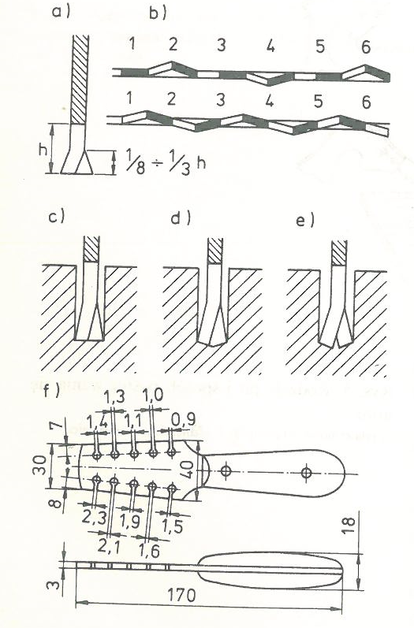
Saw teeth opening
a) correct setting
b) methods of opening
c) correct setting
d) incorrect setting
e) too large an opening
F) single-arm retractor
Notes:
To prevent the saw blade from jamming and heating up during sawing, and thus to reduce the physical effort of the person cutting the saw, properly open the saw teeth. The teeth are bent at the same angle outside the saw blade, and the bending must be consecutive and alternating, i.e. one tooth is pivoted to one side, and the next one to the other side. The ways of setting the saw teeth are shown in Figure.
On the figure the differences of saw teeth setting were presented:
a) correct setting; b) methods of opening; c) correct setting - teeth first set and then sharpened; incorrect setting - teeth first sharpened and then set; e) too large an opening; f Single-arm retractor.

Slide 7
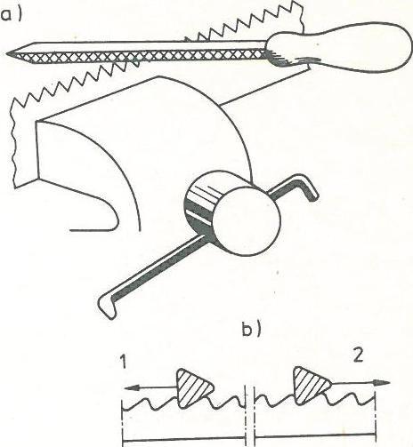
Sharpening the saw teeth
a) fixing the saw in a vice;
b) sharpening schemes
1 - "under the tooth"
2 - with the direction of the tooth inclination
Notes:
After prolonged work, the saw teeth become blunt and as a result, the wood fibers are not cut, but partially torn out, and the wood peels in places. In addition, sawing with a blunt saw requires a lot of physical effort. The saw is sharpened after the teeth are opened. Clamping the saw blade in a vice should be such that the teeth inclination is directed to the right. The figure presented different kinds of sharpening the saw teeth: a) fixing the saw in a vice; b) sharpening schemes 1 - "under the tooth" – which is correct, 2 - with the direction of the tooth inclination - which is incorrect.

Slide 8
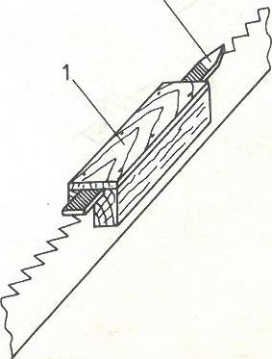
Aligning saw teeth
1 - wooden trough,
2 - flat file
Notes:
Saw blades, after prolonged use, and especially with incorrect sharpening, can have uneven or even broken teeth. The teeth should then be aligned. For this purpose, a device what was presented on the figure is used, consisting of a wooden tray (what was presented as 1, noted wooden trough) in which a flat file (what was presented as 2, noted flat file) is placed. The tray with the file moves along the tips of the teeth until it reaches the level of the lowest tooth. This work is strenuous and profitable only with small differences in the height of the tines.
During sawing, use the entire length of the saw blade, while moving "away from you" (working movement), you should exert light pressure, and when moving "towards yourself" (idle movement), the saw blade should be slightly raised. When sawing, the inclination of the saw blade to the horizontal plane of the cut element is also important. When cutting the wood across the grain, a much greater saw slope is recommended - close to the level. The first strokes of the saw are made towards each other only to create a groove for the saw blade.
The plywood should be cut with a fine-toothed saw, e.g. with a spine. To do this, turn the plywood with the left side downwards so that the right side does not cause any cuts caused by the saw teeth tearing out the veneer pieces. In the absence of a fine-toothed saw, a piece of a board or plywood should be placed under the section to be cut and cut through both pieces.

Slide 9
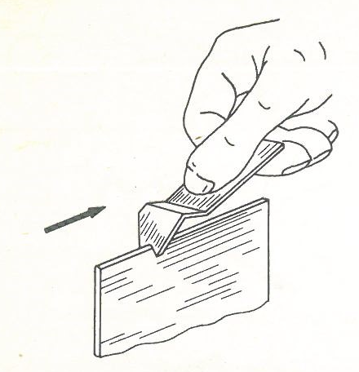
Tool for deburring
A simple tool can be made to remove burrs created during plywood sawing.
By putting the plate with the cut out to the edge of the processed material and moving it "towards you", the edges of the material are aligned and deburred.
Notes:
A simple tool shown in the figure, can be made to remove burrs created during plywood sawing (also textolite, plexiglass and other materials). hitting a hacksaw a piece of cloth in the shape of a triangle. The edges of this cutout should be sharpened with a file. As the cutout is triangular in shape, the tool is suitable for deburring the edges of workpieces with different thicknesses. By putting the plate with the cut out to the edge of the processed material and moving it "towards you", the edges of the material are aligned and deburred.

Slide 10
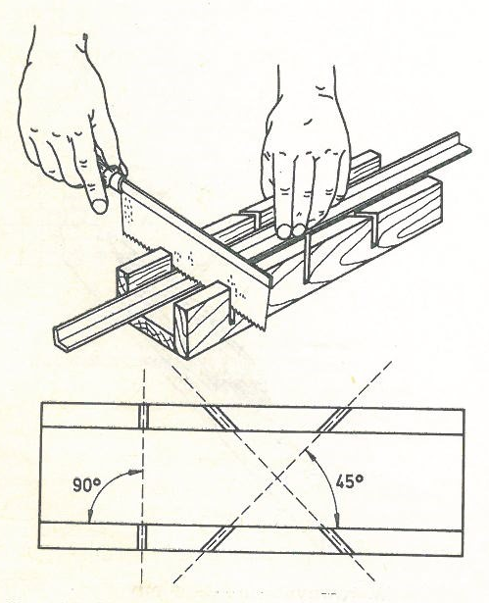
Miter box
The internal width of the box and its length can be any.
The cuts made in the side walls are a good guide for the saw blade.
Notes:
The exact cutting of wood at an angle of 90° and 45° is made easier by the miter box that was presented in the figure, which you can easily make by yourself. The box consists of three parts: the bottom and two side parts. The internal width of the box and its length can be any. After breaking the box, cuts are made in its side walls at an angle of 90° and 45° in two directions. When cutting, the element is inserted into the box, held with one hand, and with the other, using a ball, cuts exactly at the required angle. The cuts made in the side walls are a good guide for the saw blade, which does not bend and jump to the sides during cutting.

Slide 11
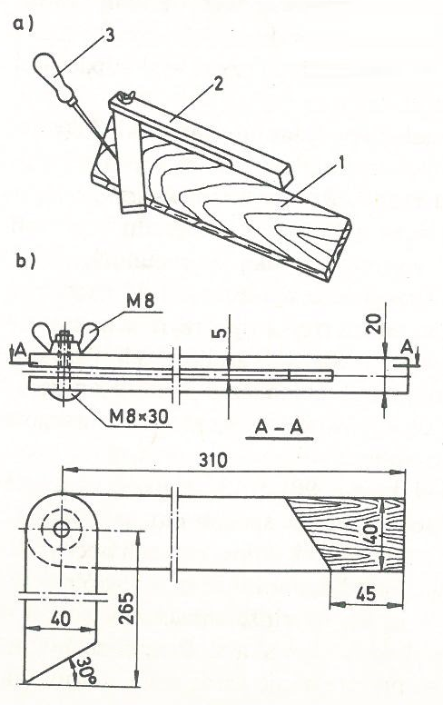
Joiner's miter saw
a) marking with a miter saw 1 - board marking, 2 - miter saw, 3 - stylus;
b) working drawing
Notes:
Shipbuilding also requires cutting at angles other than 90 ° and 45 °. For marking such angles, an adjustable square, called a carpenter's miter saw, is used, what was shown in the figure as a, by marking with a miter saw, where 1 - is board marking, 2 - miter saw, 3 - stylus.
Wood waste, preferably beech, is used to make it. First, a shaft with dimensions of 24x45x340 mm and an arm with dimensions of 9x45x290 mm are cut out. These elements are rough machined and then formed according to the construction dimensions, what was shown in the figure as b as working drawing. After the two parts are carefully processed, they are put together, clamped in a planer or on a carpentry table and cut out semicircular foreheads.
Mark the slot on the shaft, cut it out, then remove the waste with a chisel and file the inside of the slot with a file. All surfaces should be smoothed with sandpaper, put the whole thing together and drill a hole for the bolt. Preserve individual elements with varnish or clear varnish, and after drying, put them together and screw them together with a screw.

Slide 12
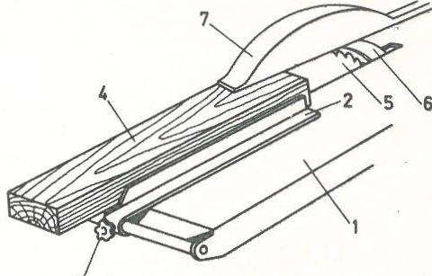
Sawing wood with a guide: 1 - machine table, 2 - guide, 3 - screw securing the guide, 4 - part to be sawed, 5 - saw blade, 6 - splitting wedge, 7 - saw guard
Notes:
Having access to woodworking machines can save a lot of time and energy. A circular saw is used to divide the lumber and make raw elements. Longitudinal sawing is aimed at preparing raw elements with a width corresponding to the width of the element increased by some excess for further processing. For this type of sawing, a guide should be used, set at the distance from the saw blade that is to be the width of the raw element. In the absence of a special saw for longitudinal cuts, the first precise cut in a straight line can be obtained by using a special pusher, which is made from a piece of a properly processed board.
The sawing wood with a guide wat was presented in the figure: 1 - machine table, 2 - guide, 3 - screw securing the guide, 4 - part to be sawed, 5 - saw blade, 6 - splitting wedge, 7 - saw guard.

Slide 13
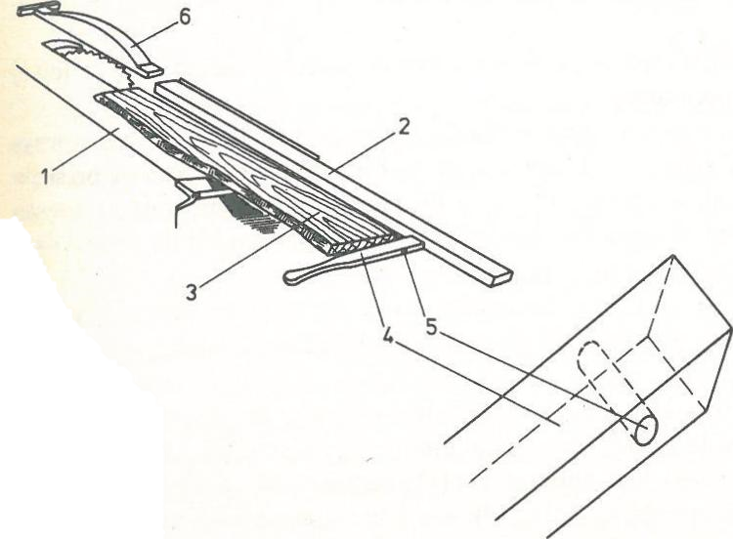
Performing the first cut on unedged sawn timber:
1 - machine table,
2 - extended guide,
3 - edged board,
4 - pusher,
5 - nail hole,
6 - saw guard.
Notes:
The appearance of the pusher and the way of using it is shown in fig. 13. The board (3) prepared for trimming should be placed on the machine table (1). Install the extended guide (2) along the guide of the machine in the form of a long, rigid, carefully machined strip. Apply the pusher (4) to the front part of the board and drive a nail into the hole (5) drilled in its side part so that the pusher's face touches the guide. By guiding the pusher's face along the guide, a straight cut is made of the board.
Figure is presenting the performing the first cut on unedged sawn timber: 1 - machine table, 2 - extended guide, 3 - edged board, 4 - pusher, 5 - nail hole, 6 - saw guard.

Slide 14
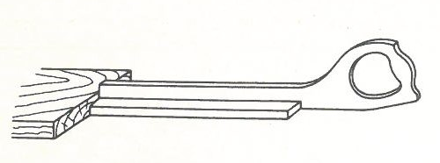
The pusher for moving boards on a circular saw
Notes:
Since sawing with a circular saw is dangerous, basic rules must be followed. To avoid injuring your fingers, be sure to use the saw guard and the special material pusher. The pusher for moving boards on a circular saw was presented in the figure.
Align the guide bar parallel to the saw blade to prevent it from jamming. The use of glasses is required to protect the eyes from dust. The riving knife is used to prevent the material from being thrown away by the saw, which is caused by the material clamping on the saw due to stresses in the wood. When sawing across the cut, it is essential to stand on the left side of the material to be cut.

Slide 15
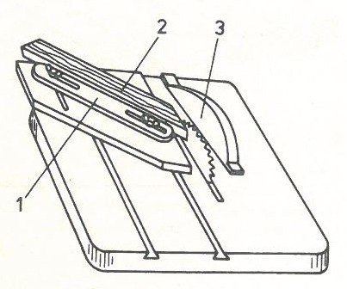
Miter sawing
1 - auxiliary device,
2 - sawing element,
3 - saw guard
Notes:
Oblique sawing is performed with the use of special equipment, which, together with the sawed board, moves along the machine table. The auxiliary device for oblique sawing is often equipped with a special protractor on which the angle at which the material should be cut is precisely set. Band saws are used for curvilinear sawing. Curves are cut out after drawing them on the surface of the material. The diagonal sawing device is shown in the figure. On that figure can be specified: 1 - auxiliary device, 2 - sawing element, 3 - saw guard

Slide 16
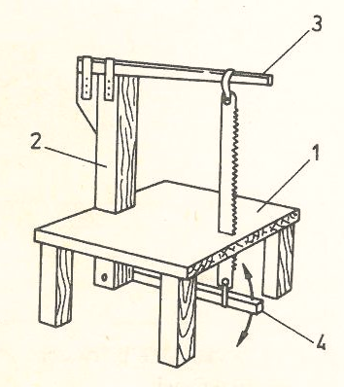
Homemade bandsaw
1 - table,
2 - beam,
3 - flexible bar,
4 - oscillating bar
Notes:
If you do not have a machine band saw, you can make a saw, similar to a band saw. The Homemade bandsaw was shown in the figure. On that figure can be specified:
1 - table,
2 - beam,
3 - flexible bar,
4 - oscillating bar
For this device, you need to make a solid table (1) and attach the square beam (2) to it at right angles. Attach a strong, flexible bar (3), e.g. made of juniper or ash, to the beam, which acts as a spring pulling the saw upwards. To the end of the bar, attach (e.g. with a metal clamp) the end of the saw blade to an ordinary frame saw, lead the saw blade through the hole cut in the table and fix the other end to the bar (4) pivoted to the other end of the beam. The end of this bar is a pedal that is pressed with the foot during sawing. Install a roller under the table that serves as a saw blade guide, against which its rear edge should rest.
A sharp saw blade should be used for sawing. To prevent it from deviating from the correct direction, the saw should be kept exactly perpendicular to the sawing surface and guide it slowly and carefully. If the saw blade becomes excessively hot during sawing, open the teeth and sharpen them. In the event of the saw blade jamming, also open the teeth and sharpen them, and for a longer cut, press a narrow wooden wedge into the cut. The wrong angle of the saw blade can also cause jamming. When the cut plywood breaks loose, the cause lies in the saw teeth being too thick. The saw should then be guided at an angle to the sheet, not perpendicular.

Slide 17
Gluing wood
Gluing combined with bending makes it possible to obtain curved elements without subjecting the wood to hydrothermal treatment.
The sale includes "Kazeinowy 416" glue for hard wood, "Kazeinowy 516" and "Kazeinowy 616" for soft wood and plywood.
This glue should be stored in a cool place, preferably in tightly closed glass vessels.
Notes:
Joining wood with adhesives allows for obtaining elements of large thickness (posts, stems), large lengths (stringers) and surfaces (sides). Gluing combined with bending makes it possible to obtain curved elements without subjecting the wood to hydrothermal treatment. Gluing stiffens the joints, and therefore allows for a wide use of various types of carpentry joints. Only waterproof adhesives should be used for gluing wooden parts of boats and yachts. The most popular glue that is readily and generally available is casein glue. It is not completely waterproof, but it is suitable for gluing water equipment, provided that the glued places are isolated from direct exposure to water by painting several times.
The sale includes glues such as "Kazeinowy 416" for hard wood, "Kazeinowy 516" and "Kazeinowy 616" for soft wood and plywood. This glue should be stored in a cool place, preferably in tightly closed glass vessels. You mix it up in such a way that you add one part of the glue to two parts of water, mix it thoroughly for a few minutes, and then let it stand for about half an hour. If the glue thickens too much, prepare a new batch, do not dilute it with water.

Slide 18
AG glue
AG glue is much better, but less accessible.
Its only disadvantage is its short shelf life, which is about a month and a half.
During places for gluing preparation, i.e. joints, it is first of all necessary to check whether the joined elements are accurately machined and matched to each other.
Notes:
AG glue is much better, but less accessible. It is a completely waterproof adhesive, insensitive to shocks, vibrations or weather conditions. Its only disadvantage is its short shelf life, which is about a month and a half. Before use, the adhesive is mixed in the ratio of 100 parts of the adhesive and 18 parts of the special AG hardener. The life of such prepared glue at 20 ° C is about one hour and it decreases with increasing temperature.
During places for gluing preparation, i.e. joints, it is first of all necessary to check whether the joined elements are accurately machined and matched to each other. Then, the glued joints should be thoroughly cleaned of dust, grease (e.g. by washing with denatured alcohol), possibly varnish and other residues. Of course, only dry wood can be glued. The temperature of the room where bonding takes place is also important and it should not be lower than 10 ° C.

Slide 19
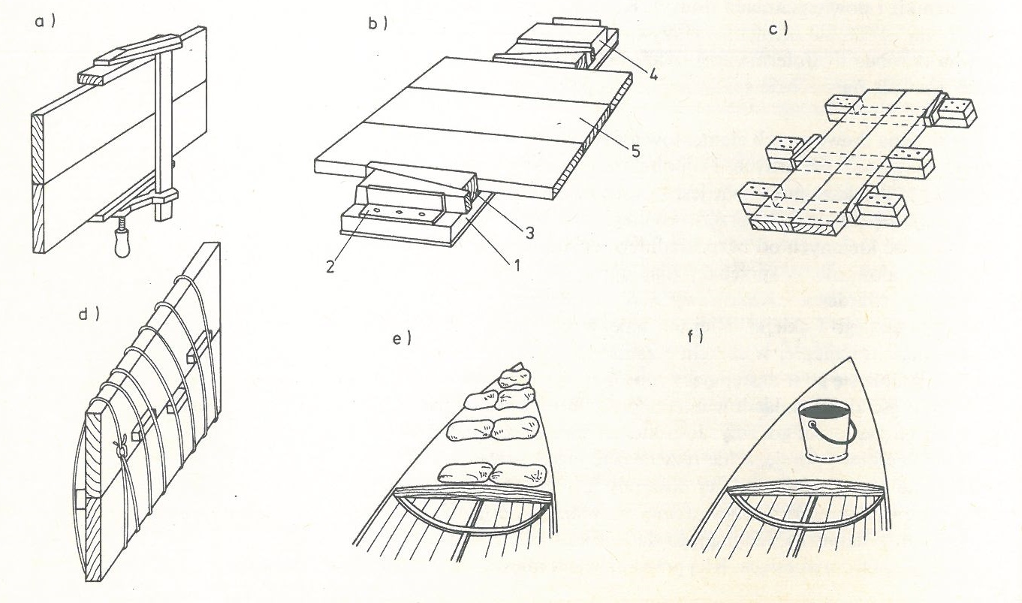
Gluing
a) gluing with a carpentry clamp,
b) gluing using a supporting board: 1 - board, 2 steel angles, 3 - wooden wedges, 4 - blocks, 5 - glued elements,
c) gluing with the help of wooden wedges and blocks,
d) gluing using applying pressure with string and wedges
e) gluing using sandbag load,
f) gluing using load with a bucket of water
Notes:
It is best to apply the glue to both glued surfaces with a brush and leave them for a few minutes. Then put the lubricated parts together and press them together with the help of wooden clamps. When gluing long pieces of wood, e.g. masts or booms, the clamps placed along their entire length should be tightened gradually and successively in such a way that the pressing force along the entire length is approximately the same. The stronger the pressure, the better the bonding will be.
Gluing with a carpentry clamp (as an a), and gluing using a supporting board (presented as figure b) was presented in the figure.
Here (signed as an b), by gluing using a supporting board can be specified:
1 - board,
2 - steel angles,
3 - wooden wedges,
4 - blocks,
5 - glued elements;
Gluing with the help of wooden wedges and blocks as an c.
d – is gluing using applying pressure with string and wedges.
e – is example of gluing using sandbag load, and f – is also example of gluing using load with a bucket of water.
To sum up all of this. In the absence of carpentry clamps, simple structures can be glued with a supporting board (presented as figure b). It consists of a base board (1) and steel angles (2) fixed at both ends. The pressing force of the glued element (5) placed on the board is regulated by means of wedges (3) and additional blocks (4). If the glued constructions are quite long, then simple devices (presented as figure c) made of strong pieces of wood and wooden blocks attached to its ends can be used for gluing them. The glued parts are pressed down with wooden wedges.
The easiest way to exert pressure during gluing is to wrap the glued elements with string or wire (presented as figure d), and then increase the pressure by inserting the wedges between the glued element and the string or wire. When gluing a plywood deck, the appropriate pressure can be exerted by placing bags filled with sand (presented as figure e) on it or, for example, placing buckets of water (presented as figure f) or even pressing bricks.

Slide 20
Template for gluing frames and stems during gluing elements on the template
1 - thick board or plywood,
2 - blocks,
3 - screws,
4 - strips,
5 - carpentry clamp.
Notes:
In amateur conditions, wood bending is performed by "dry" gluing on templates or by "hot" bending. For "dry" gluing, appropriate templates should be made. The Template for gluing frames and stems during gluing elements on the template was presented in figure.
On that figure can be specified: 1 - thick board or plywood, 2 - blocks, 3 - screws, 4 - strips, 5 - carpentry clamp.
To make them, you need thick plywood (1) or another board with a thickness of more than 20 mm. On this board, mark out the shape of the glued element, and then, along the drawn line, fix hardwood blocks with screws (3) and nuts in such a way that their front walls give the total outline of the glued element. Longer blocks (2) are mounted on straight sections, and short ones on rounder ones. These blocks do not have to touch each other, because the covered strip will follow the drawn line anyway. Then a few strips (4) coated with glue are folded together and screwed together with carpentry clamps (5). Clamps should be fastened every 15-20 cm. After the glue dries, the moldings will retain the required shape.

Slide 21
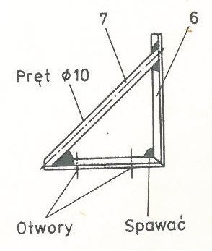
Template for rebate and stem gluing - stem gluing holder
6 - angle bar,
7 – rod.
Notes:
The same is done when gluing the stem, but if it is a stem of quite large dimensions, instead of blocks, special holders should be made from an angle bar (6) with dimensions of 30x30x5 mm. The height of the handle depends on the width of the stem. The angle section - after a suitable incision - is bent at an angle of 90 °, and a rod (7) with a diameter of 10 mm should be welded as the hypotenuse. In the lower part of the angle bar, two holes are drilled through which the holder is attached to the board with screws. The handles are attached every 20 cm in such a way that their foreheads are always tangent to the drawn line.

Slide 22
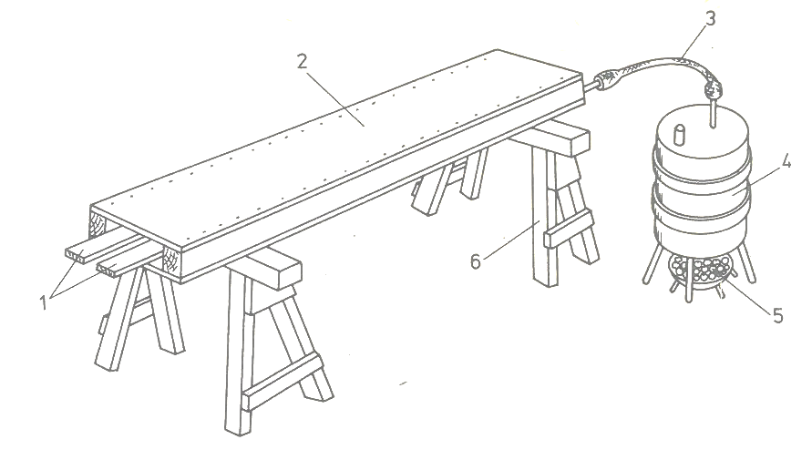
Steaming the strips in the steam box
1 - pairing elements, 2 - steam box, 3 - rubber, 4 - metal barrel, 5 - hearth, 6 - goats
Notes:
Hot bending is less labor intensive than gluing, because the tedious process of cutting and processing the strips and gluing is eliminated. On the other hand, bent elements are weaker and it is difficult to predict whether the material has hidden defects inside. For bent elements, the same templates are prepared as for gluing, but the steps are slightly different. The material to be bent can be plasticized by evaporation or by boiling. An amateur way of pairing elements in a work box is presented in figure.
All elements that were used for steaming the strips in the steam box was noted as:
1 - pairing elements, 2 - steam box, 3 - rubbr, 4 - metal barrel, 5 - hearth, 6 - goats
The material (1) prepared for bending is placed on the pads in the steam box (2) made of e.g. plywood or boards and open on one side. The box is placed on an elevation (6). A rubber hose (3) connected to a metal barrel (4) is connected to the evaporation box. The barrel is 3/4 filled with water so that steam can collect in the remaining volume. A fire starts under the barrel in the furnace (5). From the moment of boiling the water, the elements are kept in the box for about 20 minutes, then they are taken out and bent on a template or bent into the hull. After drying, the elements retain their shape.

Slide 23
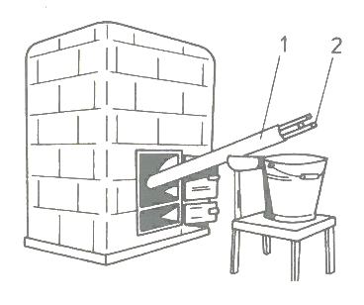
Cooking slats in a pipe
1 - metal pipe,
2 - elements prepared for bending.
Notes:
The cooking process is similar, for which a metal pipe with a larger diameter (about 100 mm) and a length depending on the length of the bent elements is used. The pipe must be "sealed" on one side by welding the metal bottom. Water is poured into the pipe and inserted diagonally into the furnace or coke oven furnace. He puts the elements (2) prepared for bending into the pipe (1) and also boils it for about 20-30 minutes, and then after taking it out, it bends on a template, remembering to hold them quite densely with clamps.
The Cooking slats in a pipe was presented in figure. On that figure can be specified: 1 - metal pipe, 2 - elements prepared for bending.

