Slide 1
Steaming and curving solid wood
Module 3
WULS
Warsaw, 1st December 2021
Notes:
In this module was prepared as part of the All Hands On Deck (AHOD) project, activity IO2A3.
The substantive transmission of the manual is the absolute minimum of sailing knowledge necessary to build a small boat in workshop conditions.
This portion of the message should be assimilated by every hobbyist of sailing.
This is also what every enthusiast of this sport should know to understand roughly the principles of sailing boat construction.
Every sailing enthusiast should improve their skills, looking for the best technique for building their dream boat.
This can be learned in two ways: either through painstaking practice or from public experience. For those who prefer the desire to acquire reliable knowledge over to the written word, further chapters are intended.

Slide 2
Unit 5. Acquiring knowledge about bending of wood by steaming in order to obtain curvilinear elements of the skeleton and planking of ships and boats
4 hour
Notes:
This unit is about the Acquiring knowledge about bending of wood by steaming in order to obtain curvilinear elements of the skeleton and planking of ships and boats.
All data will be presented in the next slides.

Slide 3
Wood Modification
Wood is the ultimate renewable material.
There are ways in which the properties of wood can be enhanced by modification through eco-friendly methods like thermo-hydromechanical treatment THT.
Craftsmen have modified wood for centuries by TH/THM treatments, but it was in the 19th century, with the construction of the Vienna Chair by Michael Thonét (1796-1871), that the industrialized process of wood molding technology was born, allowing its products to be commercialized all over the world.
Notes:
Wood is the ultimate renewable material. It possesses qualities that have made it a material of choice for millennia and these qualities are further enhanced by its recognized carbon sequestration. Moreover, the polymeric components of wood and its porous structure confer on it a noble, versatile, and general-purpose character and a faculty for transformation exceeding that of all other materials. The unique advantages of this material, its widespread availability, sustainable renewal, favorable ecological assessment, and its flexibility of implementation, give this worthy material its letters patent of nobility in the eyes of scientists and engineers. Nevertheless, the fact that wood is a natural product originating from different individual trees imposes limits on its use. This natural material may need to be transformed in order to acquire the desired functionality.
There are ways in which the properties of wood can be enhanced by modification through eco-friendly methods. One emerging eco-friendly method is the combined use of temperature, moisture, and mechanical action, the so-called thermo-hydromechanical treatment. There are numerous thermo-hydro-mechanical processing techniques and the number of these processes is growing continuously. T term hydro-mechanical processing is implemented to improve the intrinsic properties of wood, to produce new materials, and to acquire a form and functionality desired by engineers without changing the eco-friendly characteristics of the material. These processes can be divided into two major categories; Thermo-Hydro treatments (TH) and Thermo-Hydro-Mechanical (THM) treatments.
Craftsmen have modified wood for centuries by TH/THM treatments, but it was in the 19th century, with the construction of the Vienna Chair by Michael Thonét (1796-1871), that the industrialized process of wood molding technology was born, allowing its products to be commercialized all over the world. Besides greatly improving the understanding of basic material properties, chemistry, and physics as well as giving rise to advances in materials and wood science, modeling techniques provided the means for engineers and researchers to engineer wood as a material and produce new materials under controlled processing conditions.

Slide 4
Hydrothermal treatment
Hydrothermal treatment involves the action of heat and water or steam on wood.
Usually they are autoclaves, cylindrical tubes with hermetic closure, to which steam pipes are brought.
The easiest way to make an evaporator is to build a chamber to which we will lead the steam pipes.
The wood should be steamed until it reaches 30-35% humidity.
In order to bend the wood, we also need a suitable device, called a hoof or a yoke.
Notes:
Hydrothermal treatment involves the action of heat and water or steam on wood. Wood, softened in this way, is more susceptible to bending. For the so-called For the evaporation of wood, you need a device in which it can be folded.
Usually they are autoclaves, cylindrical tubes with hermetic closure, to which steam pipes are brought.
Of course, in artisanal conditions, it is impossible to have the above-mentioned ones, but you can make a home-made steamer or a bathtub in a quite accessible way. Evaporators can be of different sizes, it depends mainly on the demand. The easiest way to make an evaporator is to build a chamber to which we will lead the steam pipes. You will also need a steam source. A properly prepared furnace will be irreplaceable.
The wood should be steamed until it reaches 30-35% humidity. For small plants, it is a good idea to soak the wood in vats or other containers with warm water. Timber that is assembled for several days, depending on the species, should absorb enough water to become plastic. In order to bend the wood, we also need a suitable device, called a hoof or a yoke.

Slide 5
Reasons for thermo-hydro-mechanical processing
The challenges being discussed are of great significance: instead of consuming the Earth’s nonrenewable resources, the use of renewable materials is being encouraged in all quarters; fossil fuels must be phased out and human consumption must increasingly reflect a concern for the climate and the environment.
Concern for the environment and the climate has put pressure on wood researchers and the wood industry.
The TH process is based on wood, water, and heat, and the T HM treatment incorporates an additional mechanical force.
Enhancing the competitiveness of timber by using an innovative upgrading method with a low environmental impact can increase the use of local materials instead of imported rare tropical hardwoods, creating added value for local timber resources, increasing profitability, providing regional income, and providing employment in regional/convergence areas.
Notes:
Never before have the forestry and forestry-related industries been so sharply in the focus of discussions concerning the major challenges for the future. The challenges being discussed are of great significance: instead of consuming the Earth’s nonrenewable resources, the use of renewable materials is being encouraged in all quarters; fossil fuels must be phased out and human consumption must increasingly reflect a concern for the climate and the environment. Whilst in service, the carbon having been fixed in wood by photosynthesis can act as a long-term carbon store. Wood-based products such as solid wood can also act as short-term carbon stores. Carbon accounts for about half of the mass of a wood product. For example, with a wood product stock of about 60 million tonnes in Europe alone, the carbon storage effect of wood products plays a significant role in mitigating ecological and societal effects. The forest industry uses renewable raw materials and manufactures eco-friendly products. Carbon is stored in the forests and in their products. This means that both forests and forest products are part of the answer to the climate challenge.
Concern for the environment and the climate has put pressure on wood researchers and the wood industry. The demand for investigations and the development of new treatments for eco-friendly products, for improving wood properties and finding alternatives to tropical hardwoods as well as to energy-consuming material processes and fossil-fuel-based materials is greater than ever before, and this is the reason why some new modification technologies are being commercialized.
The TH process is based on wood, water, and heat, and the T HM treatment incorporates an additional mechanical force. This is an environment-friendly process that uses a recyclable and renewable natural resource that decreases the CO2 in the atmosphere. At the same time, TH/THM processes consume relatively little energy. The result of studies in different fields of T H/THM processing also indicates that the properties of wood such as its dimensional stability, strength, surface hardness, and durability are improved.
Enhancing the competitiveness of timber by using an innovative upgrading method with a low environmental impact can increase the use of local materials instead of imported rare tropical hardwoods, creating added value for local timber resources, increasing profitability, providing regional income, and providing employment in regional/convergence areas. People are also starting to recognize the advantages of combining renewable sources such as wood with an environmentally acceptable processing technique in order to achieve new high-quality materials. Thermo-hydro-mechanical processing as a base for product improvement and the development of new product-market combinations is now of significant interest in the industry. Potential areas of application for thermo-hydro-mechanical processing include the building industry, furniture manufacture, improving service lives of wood products through increased durability and stability, wood-finish compatibility, and new market areas now being identified.

Slide 6
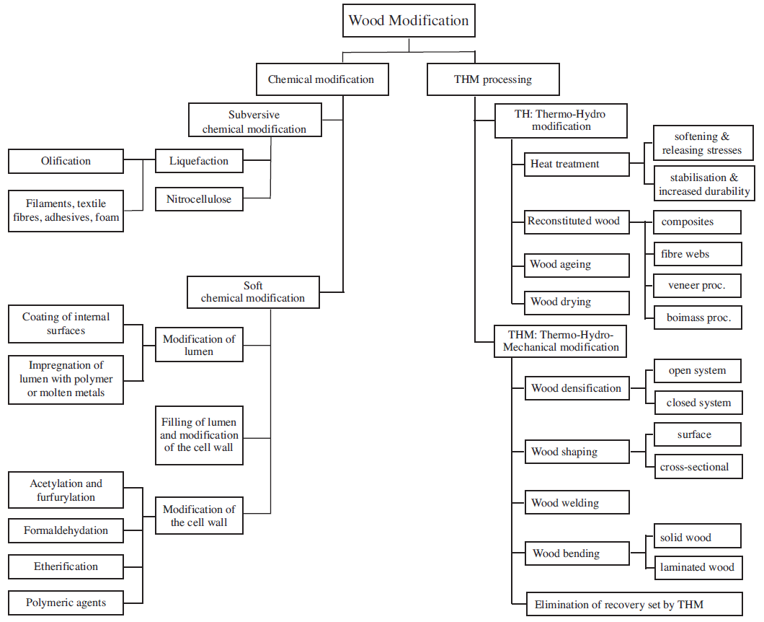
Modification of wood
Notes:
For TH/THM wood modification the specially adapted tools and instruments are used. They were created in a long period of time, by riching the experience gained during several millennia of wood TH/THM treatment, and especially the role of wood science, chemistry, mechanics, and physics on the recent techniques of wood thermo-hydro-mechanical processing. To modify wood, two treatment types are implemented: chemical treatments and TH/THM treatments. The former are much more numerous and the range of chemical agents is very broad, whereas, for the TH/THM treatments, only heat, water, and mechanical forces are employed. Displays a simplified synoptic diagram of the current chemical and THM treatments were presented in figure.

Slide 7
Chemical modification
The most promising application of this technology is developed in the area of reconstituted wood products.
Generally, two classes of chemical treatments can be distinguished: subversive and soft.
The soft chemical treatments, on the other hand, leave the crystalline structure of wood intact and touch only the amorphous part and the side groups (functional groups) of the wood components at the molecular level.
The soft chemical treatments of wood are mainly implemented to reduce the hygroscopicity and mechano-sorptive creep and increase the resistance to micro-organisms.
Notes:
Chemical modification of wood is defined as any chemical reaction between a reactive wood cell component and a chemical reagent, with or without a catalyst, giving rise to a covalent bond between the two components. The most promising application of this technology is developed in the area of reconstituted wood products, e.g., particle boards, plywood, and veneer-based products and in the enhancement of the dimensional instability, resistance to biological degradation (durability) and resistance to fire of the wood.
Generally, two classes of chemical treatments can be distinguished: subversive and soft. The subversive treatments are those that enter into the core of the cellulose fibrils. They break down the crystalline structure of cellulose and eliminate the multilevel and hierarchical structure of wood. These treatments radically modify the chemical components of the wood, and consequently, the material produced lacks practically all the intrinsic characteristics of untreated natural wood. Examples of subversive treatments are liquefaction and olification of lignocelluloses, where liquefaction is adopted mainly to produce oil from biomass under very severe conditions. Converted celluloses to oil using reactive chemicals, under high temperature and high pressure. T his type of liquefaction is called olification of lignocelluloses. Other recent types of liquefaction involve the dissolution of chemically modified wood or even untreated wood in a solvent. Applications of these types of liquefaction have been developed in the preparation of adhesives, moldings, foams etc. Nitrocellulose (cellulose nitrate) is prepared by treating cellulose with a mixture of nitric acid and sulfuric acid. It is employed as a propellant or low-order explosive (guncotton) and as a film-forming resin in the inks and coatings market.
The soft chemical treatments, on the other hand, leave the crystalline structure of wood intact and touch only the amorphous part and the side groups (functional groups) of the wood components at the molecular level. These treatments allow the microstructure of the modified wood to remain more or less unchanged. In this category, some typical treatments include formal dehydration, acetylation, etherification, impregnation by carbinol and maleic acid, impregnation by vinyl resins, impregnation by polyethylene glycol (PEG ), impregnation by phenol-formaldehyde resin, filling by metal alloys of low melting point, etc. These treatments can lead to improvements in certain physical and mechanical properties of wood, such as hygroscopicity, resistance to micro-organisms, and fire resistance, as well as in its mechanical behavior with respect to the moisture variations. There was also investigated the influence of various soft chemical treatments on the mechanical and physical characteristics of wood, and they have shown that some treatments improve certain properties of wood but are likely to lead to deterioration in others. For example, the impregnation of wood with a polyethylene glycol (PEG) resin reduces the hygroscopicity of wood but at the same time increases the mechano-sorptive creep deformation. In contrast, acetylation can simultaneously reduce both the hygroscopicity and the mechano-sorptive creep behavior of wood.
The chemical treatments that involve a radical modification of the wood structure, i.e., subversive chemical wood treatment, constitute a delicate field, which requires a detailed study of the organic chemistry. The soft chemical treatments of wood are mainly implemented to reduce the hygroscopicity and mechano-sorptive creep and increase the resistance to micro-organisms.

Slide 8
Thermo-hydro and thermo-hydro-mechanical modification of wood
improve dimensional stability and reduce the wood hygroscopicity;
enhance the resistance to micro-organisms;
achieve accelerated aging of the wood;
release internal stresses (reduce the recovery set) and soften the wood through wet heating.
Notes:
The TH/THM treatments have an important advantage over the chemical treatments since the products of the TH/THM wood are particularly environment-friendly. During thermo-hydro-mechanical processing, no chemical agents are introduced into the wood and no subversive chemical degradation affects any of its components. Under TH/THM treatments, many types of processes are developed to produce different products as a result of the laboratory level or in industrialized commercialized processes. The TH treatments include many types of processes, such as those to:
1. improve dimensional stability and reduce the wood hygroscopicity;
2. enhance the resistance to micro-organisms;
3. achieve accelerated aging of the wood;
4. release internal stresses (reduce the recovery set) and soften the wood through wet heating.

Slide 9
TH treatment of reconstituted wood products,
densification, i.e., T HM densification in a closed or open system;
wood shaping by surface densification and embossing;
wood shaping by wood cross-sectional transformation;
wood welding;
wood bending, i.e., solid wood bending and laminated bending; and
THM treatments to eliminate the shape memory of densified wood.
Notes:
One can also perform a TH treatment of reconstituted wood products, e.g., wooden composites, paper, fiber-boards, plywood and wood plastic composites. The THM treatments include
1. densification, i.e., T HM densification in a closed or open system;
2. wood shaping by surface densification and embossing;
3. wood shaping by wood cross-sectional transformation;
4. wood welding;
5. wood bending, i.e., solid wood bending and laminated bending; and
6. THM treatments to eliminate the shape memory of densified wood.

Slide 10
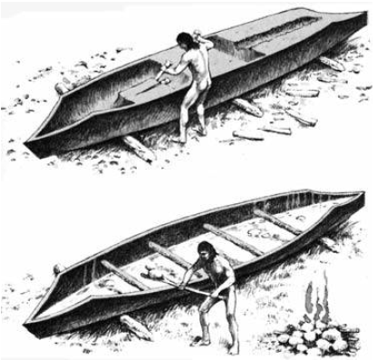
The construction of a canoe
Notes:
The fact that wet wood can be shaped under the action of mechanical and thermal loads has been known for a very long time. The various stages of the construction include the preparation of the hull starting from a trunk, heating of the hull of humidified wood, giving the desired shape to the canoe, and mechanical fixing to maintain the given shape. Mallets and wedges are used to hollow out the interior of the trunk. The trunk is then scraped to give it the desired thickness; one finger thickness for the upper part and two fingers for the bottom. In order to widen the canoe and give it the final shape, it is filled with water to humidify the wood. The water is then heated to boiling by heated stones. The fire lit at the side also heats the outside of the canoe. Once the wood has been softened by the hot water and fire, the wooden beams are set up to widen the hull, fixing and maintaining the desired shape. The principles used in the construction of a canoe by an elementary and ancient THM process were presented in figure.

Slide 11
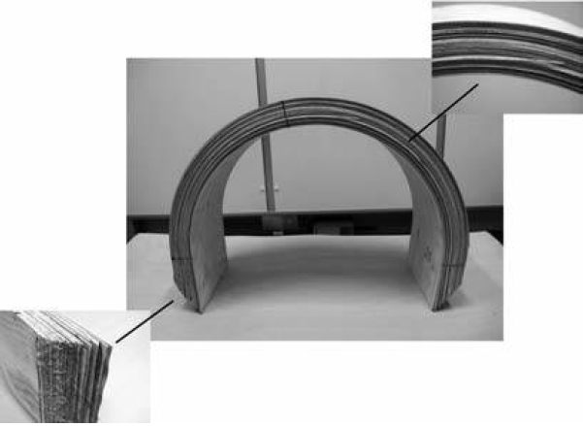
The steamed wood shaping
Notes:
The shaping of steamed wood has been employed since antiquity and has been carried out in numerous ways. Plasticization of the solid wood in order to make it possible to bend the piece without fracture is the most common way of shaping, e.g., for ship construction. The bending can be achieved in one or in two planes as well as in different directions in the same plane. Wood is normally bent after pre-steaming in various types of strapping devices that minimize the effect of tension on the convex surface and maximize the compressive yield on the concave surface, thus limiting the risk of breakage.
Another process involving the shaping of wood is the technique of laminated bending that is primarily directed towards the bending of veneers for other than structural purposes, such as in sports goods, furnishing details, etc. The need to increase the efficiency of the process of manufacturing wood veneer products and the increasing importance of laminated bends in structural applications has led to an increasing interest in a basic understanding of the wood material and the process. The fundamental mechanisms that must be understood and developed for bending laminated wood for structural purposes and for non-structural members are however similar, especially when the radius of curvature is small. The examples of products made by solid wood bending and laminated bending was presented in figure.
Wood can be densified and its properties modified not only by filling its void volume with polymers, molten natural resins, waxes, sulfur, and even low fusion metals but also by compressing it under conditions such that the structure does not become fractured. Densification is the process whereby the wood density is increased by reducing the void volume of the lumens in the wood material.
In Inwood shaping, the wood can be processed either at the surface or in the cross-section of the wood. Embossment is a process where the surface of the wood is partially densified, normally by a steel tool, to create a decorative pattern on the surface. This process is comparable with the methods of densification of wood, but its main purpose is not to increase the density of the wood, but only to shape the wood surface. Embossment has a long tradition. For example, the art of pressing, engraving, and fretting patterns into wood has been a part of I ran’s ancient history and goes as far back as 5000 years when it comes to the interior design of palaces, boxes laid over tombstones, pulpits, and book-racks. The advances achieved during the 20th century in wood material science and engineering provided the means for engineers and researchers to develop new eco-friendly materials from the wood.

Slide 12
The thermo-hydro treatment of wood
The reasons for heat-treating the wood is to improve some of its intrinsic properties such as dimensional stability, resistance to micro-organisms, stress relaxation during the forming of wood-based composites, veneer production, woodcutting, and wood fracture resistance.
Currently, this technique is implemented to make artificially aged wood, so-called accelerated wood aging.
Notes:
The thermo-hydro treatment of wood constitutes a modification technique since the wood constituents undergo chemical changes during the treatment. The reasons for heat-treating the wood is to improve some of its intrinsic properties such as dimensional stability, resistance to micro-organisms, stress relaxation during the forming of wood-based composites, veneer production, woodcutting, and wood fracture resistance. Currently, this technique is implemented to make artificially aged wood, so-called accelerated wood aging.

Slide 13
Timeline of Thermo-hydro wood processing studies
Over the 40th investigated the effect of heat and processing time on the dimensional stability of wood.
In the middle of the 60th was reported that, although the dimensional stability and set recovery of compressed wood.
In 70th the effects of temperature, pressure, and moisture content were studied.
During the 1980s, French and Japanese industries began to study the heat treatment of wood in a closed system in order to increase microbial durability.
Notes:
Over the 40th investigated the effect of heat and processing time on the dimensional stability of wood. Wood was immersed in baths of molten metal at temperatures between 140 and 320 °C, and it was reported that heating for seven hours at 260 °C reduced the swelling of Sitka spruce by 60%.
In the middle of the 60th was reported that, although the dimensional stability and set recovery of compressed wood were improved by heating, certain parameters related to strength were reduced to an unacceptable level, particularly the surface strength. Hence, it was predicted that the dimensional stabilization of wood by heat had no future.
In 70th the effects of temperature, pressure, and moisture content were studied to find the optimum conditions for the heat-stabilization of different species of wood, and a heat-treatment method called FWD (Feuchte-Wärme-Druck) was launched. The optimum conditions for pinewood for instance were stated to be a moisture content of 20-30%, a temperature of 160 °C, and a pressure of 0.7 MPa. A considerable resistance towards brown rot fungus was reported, and the strength reduction was stated to be insignificant.
During the 1980s, French and Japanese industries began to study the heat treatment of wood in a closed system in order to increase microbial durability. Since then, the interest in heat treatment has increased all over the world. The process essentially involves a controlled degradation of wood, primarily resulting in the destruction of hemicelluloses. Several different methods are included. The basic diversity of the different processes is indicated by their oxygen-excluding and heat transporting media. Substantial similarity is that these processes run in a temperature range between 180 and 240°C to change the chemical composition of the cell wall. Due to a severe loss of strength, TH treatments of wood at elevated temperatures above 300°C are limited. The temperature is achieved with superheated steam in a vacuum, or with an inert gas such as nitrogen. Pre-heated oil can also be used in the process. A simplified picture of the results obtained from the heat-treatment methods indicates that heat treatment increases the stability and durability but also the brittleness of wood and leads to a loss of certain strength properties including impact toughness, modulus of rupture, and the work to failure.

Slide 14
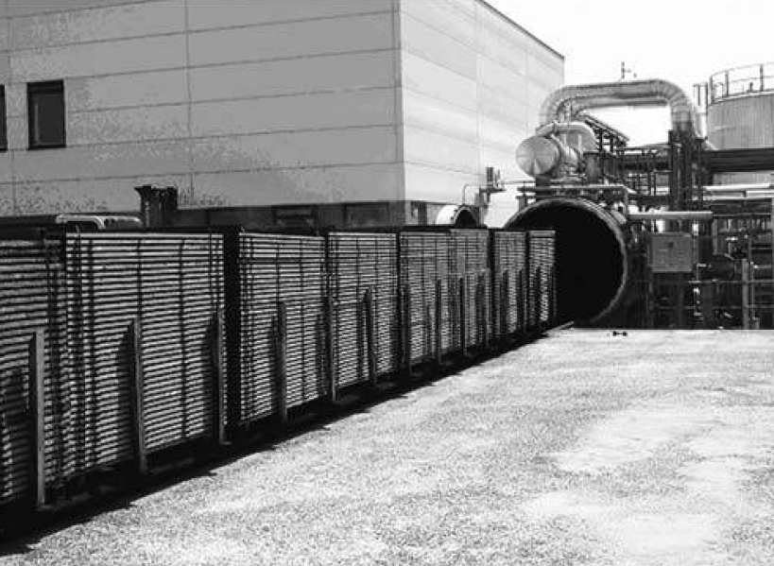
Heat treatment according to the Plato process in a thermo-hydro vessel
Notes:
The commercializing of industrial heat-treated wood products is a recent advance. This type of industry aims at improving the biological durability of less durable wood species and enhancing the dimensional stability of wood or wood-based products, e.g., particle boards. The properties of industrially produced heat-treated wood, in general, have been intensively investigated in recent years. On the European market, several industrial heat-treatment processes have during the last few years been introduced using closed systems.
The most widespread industrial heat-treatment process of wood is the seasoning sawn wood in kilns. This process is performed at temperatures below 100 °C, i.e., low-temperature convective drying, or above 100 °C, i.e., high-temperature drying. Thermal modification of wood may be viewed as an extended seasoning process, which ends with an increased temperature period when all the water in the wood has vaporized. One heat-treatment chamber for controlling the temperature and humidity of a two-stage treatment plant was presented in figure.
Can be noticed the heat treatment according to the Plato process in a thermo-hydro vessel, 20 m long and 2.4 m in diameter, with a controlled temperature and humidity (by courtesy of the Plato International BV, the Netherlands).

Slide 15
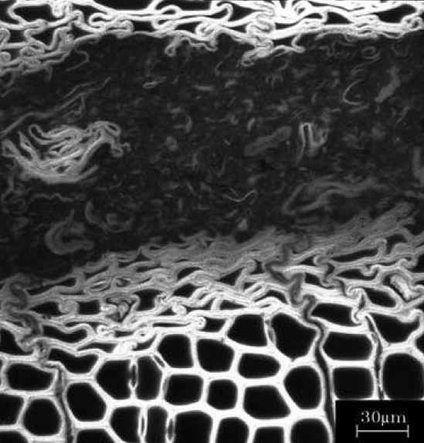
heat-affected zone and the adjacent regions
Cross-sectional view of a confocal laser-scanning micrograph picture
The heat-affected zone and the adjacent regions of friction-welded N orway spruce.
Notes:
In a TH process, wood is heated in water to soften it and to release its internal stresses. A common industrial TH process is steaming and boiling logs before slicing or rotary peeling them to veener. Actually, the boiling temperature of the water is seldom reached. Almost always, the temperature is lower than 100°C. TH processes have also been extensively studied as a technology for the processing of biomass for the production of sugars. That's why for several decades, friction welding has found broad applications in many metal and plastic industries.
In 90th the studies of joining wood pieces by means of pressure and frictional movement were attempted. It was noticed, that two pieces of wood can be welded by means of an oscillating or linear frictional movement. Early work in joining pieces of wood by friction welding, was noticed that demonstrated that during the welding process the contact zones between two wooden pieces were joined together by “molten wood” through the heat produced during the frictional movement. The movement causes a thermal alteration of the wood cells, which leads to the formation of a viscous layer or “molten wood”. After stopping the friction movement and cooling, the material in the contact zone forms the connection between the pieces, as displayed in Figure.
Investigations of the welded wood show that the strength achieved by this method is close to that obtained using conventional glues, but that the strength of friction welded joints decreases at high humidity. The development of a relatively high initial resistance also permits for instance the continuous welding of multilayered laminates. In this technique, the temperature of the wood between the welded surfaces may rise to more than 400 °C during welding. Moreover, the total welding processing time is short, about 10-20 seconds. These techniques have attracted industrial interest.
Mechanically induced vibration wood-welding techniques can also be utilized to obtain wood surface finishes with a greater surface hardness and performance in the presence of polymerizing unsaturated oils, such as sunflower oil or other polymerizing finishes.

Slide 16
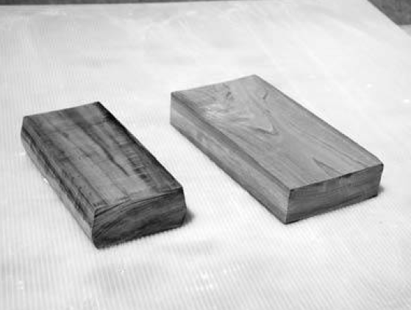
Compressed Lumber Processing System
Notes:
Compressing wood in the transverse direction reduces the void volume of the lumens in the wood material and increases its density. This process is commonly called densification. The idea of wood densification by compressing the wood in its radial direction existed begin in 1886. Next on 22th, the method for densifying wood by impregnation with rubber was developed. Until the year 1945, this type of wood was used in the aviation industry when it was replaced by aluminum. Compressed solid wood has also been made in Germany since the early 1930s and commercialized under the trade name of Lignostone, a corresponding laminated compressed wood under the trade name of Lignofol, and a resin-treated laminated compressed wood under the name of Kunstharzschichtholz.
The first aim of the densification was to improve the mechanical behavior and moisture sorption of wood. At present, the objective of wood densification is manifold and includes numerous processes, such as wood shaping, enhancing the intrinsic mechanical, physical properties of the wood, producing high-quality wood, wood surface densification. One of the reasons for densifying wood in the transverse direction is to produce high-quality timber from timbers of low quality. A process developed in Japan called “Compressed Lumber Processing System” transfers a local timber with a low density of about 300 kg/m3 to timber with a density greater than 900 kg/m3. The elements fabricated by this THM process at a temperature of 180 °C were presented in figure.
However, densified wood shows an undesired behavior, i.e., a tendency to recover all or part of its compression-set and return to its initial dimensions when subjected to heat and humidity. This phenomenon is called “shape memory” or “compression-set recovery”. Various wood products (bentwood, densified wood, wood surface densified wood, molded wood, and compressed wood fibers) suffer from shape memory. To overcome this issue, impregnated the wood after compression with a phenol formaldehyde resin. The wood was then heated for 10 to 20 minutes to polymerize the resin. This type of compressed and impregnated wood was called “Compreg”. Had thus succeeded in partially eliminating the shape memory of densified wood by a TH treatment. During advanced investigations of the densified wood treatment in THM processing has been noticed that the THM post-treatment of densified thin wood specimens at 200°C for only 4 minutes was sufficient to eliminate almost totally the shape memory of densified wood. On the other hand, the thermal treatment of wood was limited to 300°C, due to severe degradation of the strength of the material.

Slide 17
Molding and wood densification
two-directional transverse densification of wood elements
wood plasticization by high-temperature steam,
compressive molding,
THM post-treatment, and cooling.
Notes:
The purpose of recent research into molding and wood densification is techniques development for THM post-treatment involving the elimination of set recovery to implement wooden elements with large dimensions. Currently, this field is still developed especially into the THM densification of wood are being carried out. These processes are based on two-directional transverse densification of wood elements and involve four stages:
-wood plasticization by high-temperature steam,
-compressive molding,
-THM post-treatment, and cooling.
Two techniques are being developed, in which small trunks of wood with circular sections are transformed into trunks with square sections; and one is known as the “Compressed Lumber Processing System”. The differences between the two techniques lie in the stage of post-treatment. In the first technique, the molding and post-treatment form a continuous process, whereas in the second technique these two stages are separated. The problems related to the dimension of the wood elements (side effects), such as the development of cracks and exfoliation during shaping, cooling, and drying have yet to be completely solved. However the problems of “compressive molding of wood under a high-pressure steam technique” require much fundamental knowledge on wood T HM behavior is required.

Slide 18
Machinery for pre-compression of wood in the longitudinal direction
compressing the steamed softened wood element longitudinally in about 20%,
releasing the applied compression, after which the wood partially recovers,
the compressed set, so that the residual deformation is about 4-5%,
allowing the wood to cool at room temperature and dry to a moisture content of 12%.
Notes:
The researches of molding and wood densification were also developed in the field of molding, densification of wood, and THM post-treatments as well. An example can be the developed machine for pre-compression of wood in the longitudinal direction. After that, this type of densified wood element can be bent without steaming and jigs. The procedure involves:
1. compressing the steamed softened wood element longitudinally in about 20%,
2. releasing the applied compression, after which the wood partially recovers,
3. the compressed set, so that the residual deformation is about 4-5%,
4. allowing the wood to cool at room temperature and dry to a moisture content of 12%.
The deformation of wood cells during densification was also studied. After the investigation was discovered, that the hydrolysis of wood hemicelluloses from origin set recovery is sufficient to almost totally eliminate the shape memory through relaxation of the stored strain energy. A system for wood heat treatment based on oil at a high temperature (OHT), was also developed in this pass of time. In this open system, rape-seed oil is used as a medium as it can be heated above 200 °C. A similar system was investigated for eliminating the set-recovery of large industrial densified wood elements. The results have shown that oil-heating at a temperature above 200 °C can completely eliminate the compression-set recovery of large densified spruce panels. Such a product has shown improved resistance against micro-organisms. Because of its improved durability and the impregnation of densified wood by oil during the post-treatment, this type of product can be used for outdoor purposes.
According to the harvesting of rapidly grown wood, with low density, the densified wood in the production usage possibility ​of composite layered materials was also investigated. To densify small low-density hybrid poplar specimens the semi-closed THM reactor was developed. This system might have had some advantages in the field of all closed systems, but unfortunately, the dimensions of specimens used for densification are small and it would be difficult to evaluate the interest of this system when employed for large sized wood elements for building and construction purposes.
At present, the technology of TH wood treatments has been industrialized and their products are being commercialized. The research in the field of wood THM molding and wood densification as well as the post-treatment of compressed wood by THM actions aims to widen this field to large-sized wood elements for applications in the building industry. Moreover, many other THM treatments are advancing at the laboratory level. However, the main characteristics of all recent TH/THM treatments are based on scientific knowledge, wood physics, chemistry, mechanics, material, and wood sciences. Understanding these treatments requires the appropriate scientific knowledge related to wood. It is essential to know the structure and composition of wood, the elasto-viscoplastic behavior of the wood according to the temperature and the wood moisture content, the effects of TH/THM processing parameters (heat, humidity, and processing time) on the mechanical properties, the chemical kinetics of reaction and degradation of wood, heat and mass transfer in wood during TH/THM processing and the mechanisms of eliminating recovery-set in THM woods.

